Slide 1


Slide 2
The USA Party http://theusaparty.com
Who is the USA Party
Who are the USA Party’s base
Special Interest Groups control our Government
Are you tired of the political non-sense
Special Interest Gurus
Giant Social-Economic Experiment
How to give power back to the people
USA Core Belief 1: States in charge of Health, Welfare, & Education
USA Core Belief 2: No Block Grants
USA Core Belief 3: Only the Wealthy pay taxes
USA Core Belief 4: Social Security is an Obligation, not an entitlement
USA Core Belief 5: Dept of Transportation independent of Treasure Fund
USA Core Belief 6: End Slavery in America
USA Core Belief 7: 11 million failures to secure border
USA Core Belief 8: America’s Asinine policy towards Coal
USA Core Belief 9: Americans don’t want JOBS; they want CAREERS
USA Core Belief 10: Education is evaluated incorrectly
USA Core Belief 11a: America must return to the MOON
USA Core Belief 11b: Commercialize space via Space Billets
Our Healthcare Plan
The 10 Commandments in Legal Terms
Water for LA and the Great Plains
Conclusion
Notes:
The USA Party. A newly formed grass roots organization that is trying to persuade people to take power away from special interest groups in DC and give it back to the people via state governments. We hope the following 18 slides will persuade you to share this video with your neighbors.

Slide 3
Who is the USA Party
THE USA Party is grass-roots organization of Independent Voting Citizens who do not see any of the present political parties as providing a clear path to a better America
THE USA Party grew out of frustration of:
  Two of worst US Presidents (Bush & Obama) that spent vast sums of American wealth on 2 meaningless wars & government giveaways.
  Petty bickering between the two major parties and
  Cheers this President gave to world leader while that leader insulted American Laws and our US Constitution in our own Capital Building on 20MAY2010! (Go to Immigration in Policy page to read the Great Insult.)
The federal government should be inspiring, guiding, and assisting its citizens to do the nearly impossible; instead our government is inspiring its citizens to ask for more handouts.
The USA Party was founded in Kentucky by an aerospace engineer (and several silent patriots) & inspired by YMCA’s Kentucky Youth Assembly
Because other founding members of the USA party may have positions with the federal government or other situations where they desire to be anonymous, only Doug Thorpe will be listed as the author on all documents.
Notes:
The federal government should be inspiring, guiding, and assisting its citizens to do the nearly impossible; instead our government is inspiring its citizens to ask for more handouts.

Slide 4
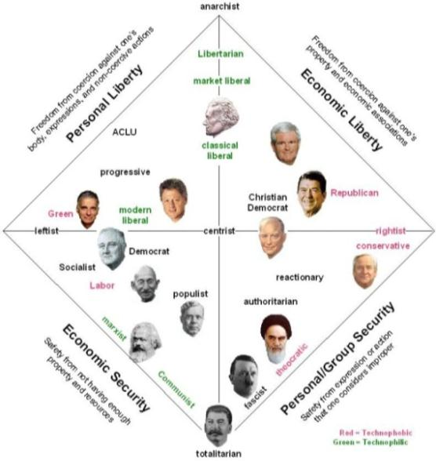
What is the USA Party & who are its Base
Reference the Noland Chart on the 5 political views; Conservative, Liberal, Libertarian, Communist, or Centralist; we hope our grass-roots organization offers a 6th option. The 6th option is none-of-the-above; it is based upon the 10th amendment.
WHO IS THE USA PARTY's BASE: We reach out to Independents, Libertarians, the Tea Party, Republicans, Centralists, Moderates, the Green Party, and “everybody else”.
We seek anybody that believes Congress and the federal government are completely out of touch with the people, they are out of control in controlling government spending, and they have over reached duties given to them in the US Constitution and those government functions should be given back to the States.
Notes:
When the simple act of growing the government by 3% less then plan is given the term “Sequester” and as a result visiting tours of the White House must be cut and passenger flights must be delayed; something must change. Hasn’t it become all too evident that both sides of the political isle are incapable of cutting even the smallest program from the budget?

Slide 5
How is the USA Party different than Libertarians or Constitution Parties
10th amendment
  The USA Party supports only those items delineated in the US Constitution plus social security; all others must be transferred to states
  Libertarian Party (LP) does not support social security nor transferring government functions to states
  Libertarians support no laws against personal freedoms (such as drug use and abortion) while the USA party would transfer those functions to the states
  LP doesn’t support welfare while USA would transfer to the states.
ACLU
  The USA Party is passionately anti-ACLU due to the ACLU’s extreme liberal agenda and pseudo war against religion
  LP website associates itself with the ACLU
RELIGION
  The USA Party desires to make Atheism a religion so ACLU can’t force the courts to eliminate all traces of religion from government
  The USA Party remains neutral at the federal level, but conservative at the state level, while LP is neutral at all levels of government.
  Constitution Party is strong right-wing conservative organization.

Slide 6
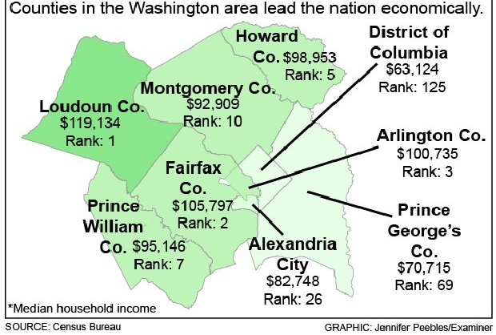
Special Interest Groups Control Our Government
Instead of a government “Of the People”, we have a government FOR special interest groups via lobbyists.
As a result, 5 of top 10 wealthiest counties in USA surround DC.
Notes:
America’s federal government is no longer a government “of the people”, but rather than a government FOR special interest groups. 5 of the 10 wealthiest counties in America surround DC and are a direct result of lobbyist for special interests and government giveaways.

Slide 7




Are you tired of the Political Nonsense?
Help us eliminate Political Hot Buttons
After years of voting for one party or another, has anything changed, or do the same people remain in power and the same political hot-buttons will be there for the next election cycle?
Notes:
American politics has been reduced to “we vs them” with an infusion of political hot buttons just to get your vote. How often have you heard:
Liberal vs Conservative,
Tax breaks for the rich,
Pro-Life vs Pro-Choice,
Diversity, Racist, or civil rights advocates,
Green Energy vs Big Oil vs Dirty Coal, or
Corporate Welfare?
After years of voting for one party or another, has anything changed, or do the same people remain in power and the same political hot-buttons will be there for the next election cycle?

Slide 8
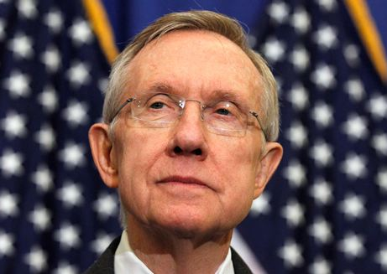
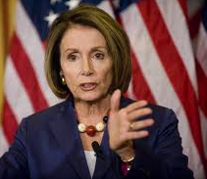
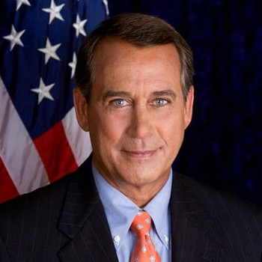
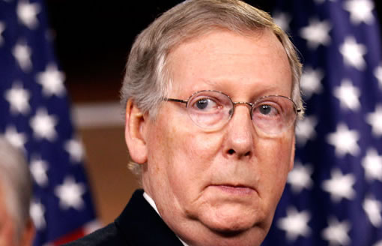
If you can’t stand the thought of:
Politicians don’t represent the majority, only groups that are organized (referred to as Special Interest groups) have the politician’s attention.
Any source of meaningless conflict (referred to as Political Hot Buttons) enables bad politicians to stay in office; by transferring government functions to states we hope to remove that conflict.
Thomas Jefferson is credited with the quote, “every generation needs a revolution”. So join the Silent American Revolution and return power to the people
Notes:
Politicians don’t represent the majority, only groups that are organized have the politician’s attention. Any source of meaningless conflict enables bad politicians to stay in office; by transferring government functions to states we hope to remove that conflict. Thomas Jefferson is credited with the quote, “every generation needs a revolution”. We hope you join our Silent American Revolution and take back an over reaching federal government.
If you can’t stand the thought of:
Nancy Pelosi
Mitch McConnell
Harry Reid, or
John Boehner
Join our Silent American Revolution and return power to the people.

Slide 9
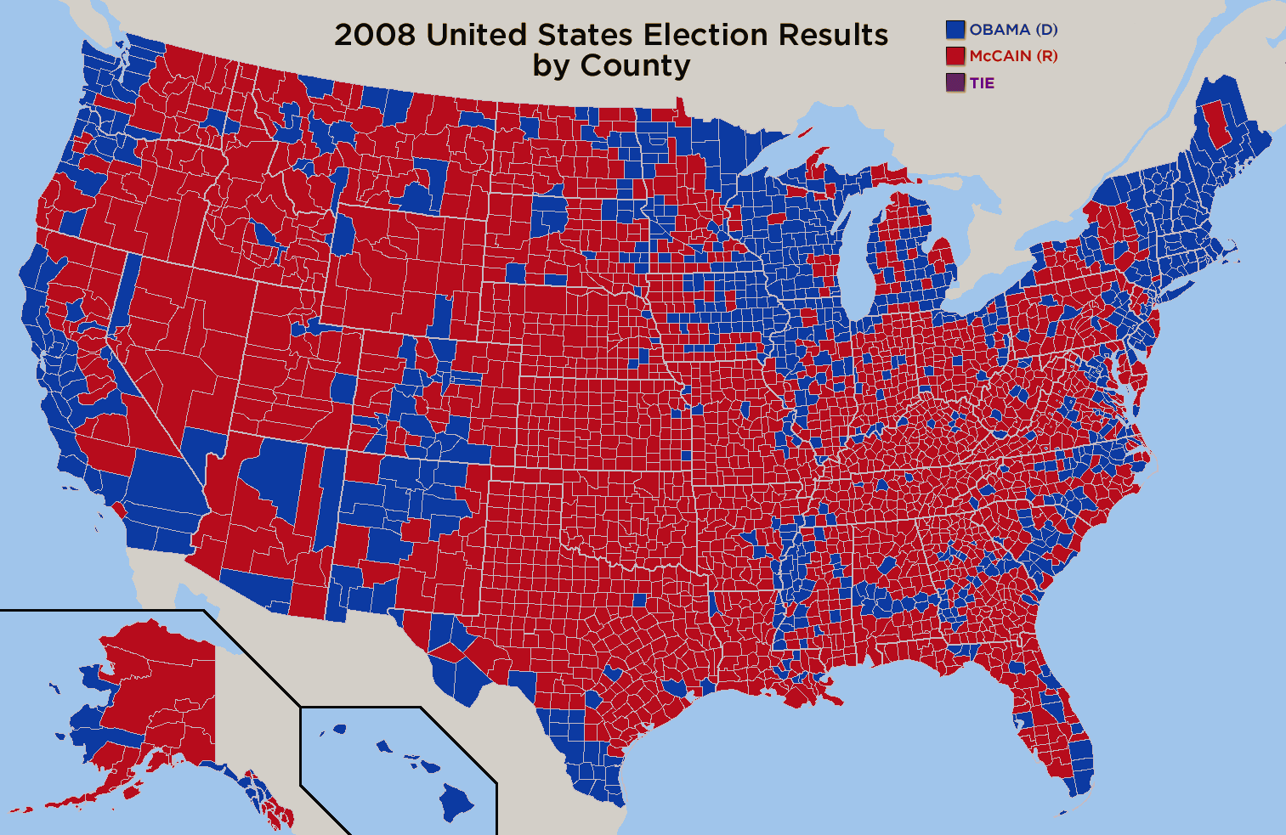
Giant Social-Economic Experiment
From the 2008 Presidential election results, it is obvious that the people of America’s heartland have a different opinion of how the country should be governed than the big cities and the Northeast.
No matter what the politicians promise, NOBODY knows how their actions affect the nation’s vitality and employment. There is no way of telling if the $1Trillion Obama stimulus plan or other actions by this administration reduced or lengthen the current recession.
At the USA Party, we wish to remove most of the power of the giant experiment and create 51 smaller social-economic experiments that will allow everybody a chance to see which one they like best and move there.
Notes:
We live in a giant social-economic experiment that swings to the left or to the right depending upon which party is in control. From the 2008 Presidential election results, it is obvious that the people of America’s heartland have a different opinion of how the country should be governed than the big cities and the Northeast. Unfortunately, you can’t easily leave that experiment if it is going in the wrong direction. No matter what the politicians promise, NOBODY knows how their actions affect the nation’s vitality and employment. There is no way of telling if the $1Trillion Obama stimulus plan or other actions by this administration reduced or lengthen the current recession.
At the USA Party, we wish to remove most of the power of the giant experiment and create 51 smaller social-economic experiments that will allow everybody a chance to see which one they like best and move there. Join our Silent American Revolution and return power to the people.

Slide 10
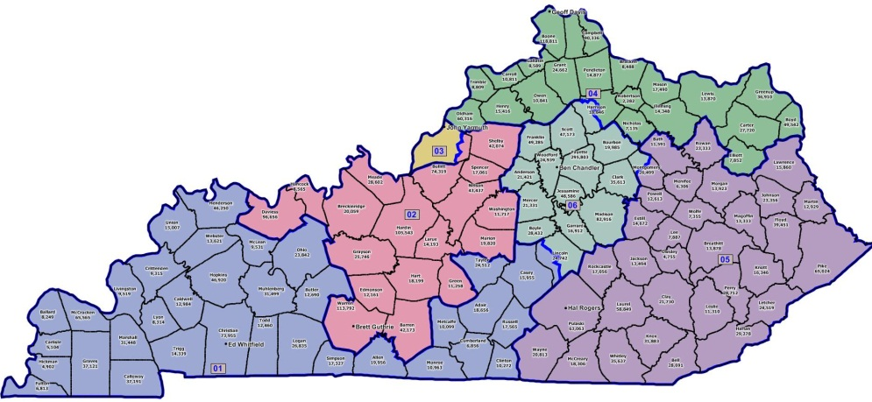
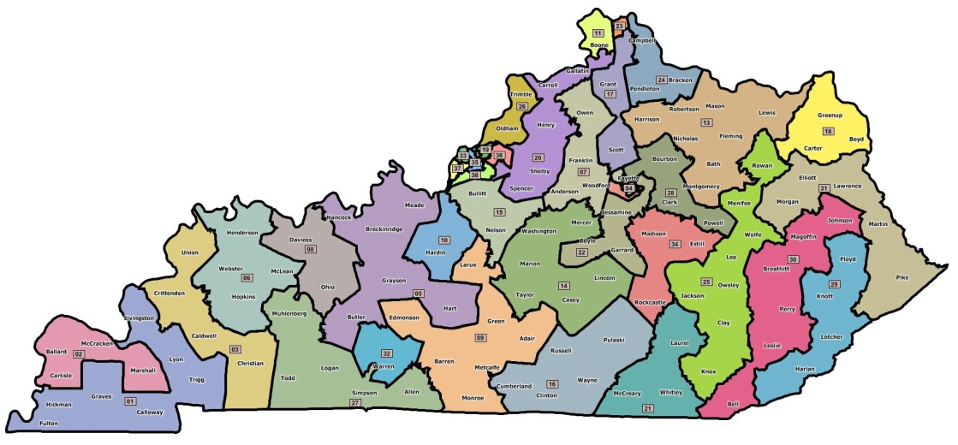

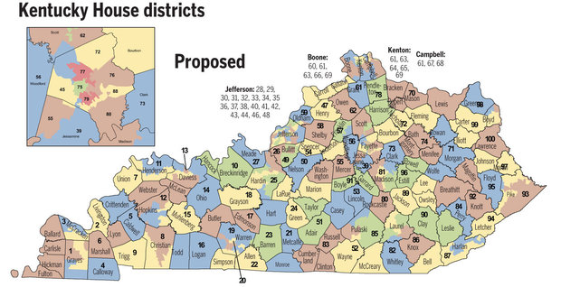
How to give power back to the people
Using Kentucky as an example: 3 maps show the 6 US districts, the 37 state senate districts, & the 100 state house districts.
Rather that wait in line to see your one US congressman, state officials work part time, answer their own phones, and will see you with short notice for a salary of only $6,000 per year.
Since most friends typically live in the same state, you can influence more state officials than US officials.
Notes:
HOW TO GIVE POWER BACK TO THE PEOPLE
The USA Party proclaims that state representatives are easier to contact than US representatives and senators. We challenge you to schedule a time to meet with your US congressman vs a state representative. What you will find out is the state representative will personally answer their phone and agree to meet with you in a short period of time while the congressman’s secretary will say the best way of meeting the congressman is to go to his DC office. When you get to DC you will find the lobbyists are paying people $36/hour to stand in line for them and your chances of meeting YOUR representative is very low.
Even under the best of circumstances, you have less of a voice in DC than in your state government. Using the state of Kentucky as an example with the 3 maps shown here; there are 6 US districts, 37 state senate districts, and 100 state house districts. While in both state and US governments, you only have 1 vote (or one representative), the people you know and who think the same way you do typically live nearby in the same state. Your friends may have different state representative’s districts but you may have the same US representative. Therefore, you and your friends can influence several state representatives, but can only influence 1 US representative. As a result, (you, the people) have more influence in state governments, but little influence in US governments; whereas, lobbyists and special interest groups can contact as many members of congress as they desire.

Slide 11
1st Core Belief
Federal Government should be ONLY responsible for those tasks that the states can not perform
No programs are cut!!! We merely transfer all jurisdiction of these programs to the states.
Federal Government Functions Functions Transferred to the States
National Defense & Foreign Policy
Border Control & Immigration
Social Security
Transportation
Space & Technology
Healthcare
Welfare
Education
Marriage
Abortion
Did you know: The US Dept. of Education has 4,400 employees and a $68B budget but does not education one student.
Functions transferred to the states amount to over $1.1T or more than 30% of the total federal budget. The states are free to fund as much or as little as they can afford
Notes:
1st Core belief: The USA Party thinks it is time to take power away from congress and give it back to the states; to give the power back to the people instead of special interest groups. We believe congress and the federal government have done such a dismal job of being responsible with the taxpayers money that they should only be responsible for those tasks that cannot be performed by the states, such as:
National Defense & foreign policy
Border control & immigration
Old age insurance (better known as social security)
Transportation
Space & Technology
States will have the total responsible for the Health, Welfare, and Education of its citizens as well as social issues such as marriage and abortion. By returning jurisdiction of these government functions to the states, the federal government will not be able to tell the states HOW to administer those functions. The states would be un-restrained on how generous they are with welfare and healthcare, but at the same time they must balance their budgets by raising taxes to cover these new functions. On the topics of abortion, same-sex marriage, and Obamacare, the power of special interest groups over congress would be totally removed. Everything is a political game, we often heard about spending more money on the education of our youth, but did you know the US Dept. of Education has 4,400 employees and a $68B budget but does not education one student.
This $1.1Trillion in new responsibilities by the states may take several years to implement but we hope it can be completed within one term.

Slide 12
2nd Core Belief
No money (no Block Grants) from Federal Government to States
Does it make sense for federal government to:
  tax citizens & corporations in states just to give the money back to states as block grants?
  borrow money just to give the funding to states as block grants?
If federal funding is given to states, there will ALWAYS be stipulations that help special interest groups.
Just Recently: The HUD stated that any city that didn’t make strides toward diversity (even when there were no complaints), HUD would punish that community.
THEY SAY, “States don’t have money for these programs.”
WE SAY, “The federal government is borrowing $1T per year, does it sound like the federal government has money for these programs?”
Notes:
2nd Core Belief: It doesn’t make sense for the federal government to raise tax revenue or borrow money, just to give some back to the states in the form of block grants. Since the congress is controlled by special interest groups, any funding given back to the states will always have stipulations that help the interests of those groups. Just recently, the HUD stated that ANY city that didn’t make strides toward diversity (even when there were no complaints), would be punish by HUD.
THEY SAY that “the states don’t have any money for these programs”. We say, the federal government is borrowing over $1Trillion per year, does it really sound like the federal government has money for these programs?

Slide 13
3rd Core Belief
THEY SAY, “Tax Breaks for the Rich”.
WE SAY, “Tax only the Wealthy & Corporations”.
Eliminate political hot button: “Tax Breaks for the Rich”
The USA Party Tax Brackets vs Current Tax Brackets
Notes:
3rd Core Belief: In order to eliminate the political hot button, “Tax Breaks for the Rich.” The USA Party thinks that only the wealthy and corporations should pay ALL federal income taxes. Our graduated tax scale maxes out at 25% for those individuals with a net income of more than $250,000 with no deductibles and no difference in how the money is earned. While our graduated tax scale starts at 1% tax on people earning $70,000, almost all of the tax revenue is produce by the wealthy. Please bear in mind that the wealthiest 10% of Americans (that is, those who earn more than $112,000 per year) already pay 55% of the total federal tax revenue for 2013. By reducing the functions of the federal government in our 1st core belief, there will be more than enough federal tax revenue just from the wealthy to fund the nation without borrowing while the wealthy will actually pay less on average than they do now. Any requests for spending on entitlements or social programs will directly result in taxes on the middleclass.
In addition, we think ALL corporations, including non-profit organizations, should pay 25% tax on all net profit. For example, the Red Cross can make as much money as they want as long as they give it all back to the community by the end of the year. In order to eliminate corporate tax shelters, which are known as corporate “offshore” deferrals, any company and their subsidiaries that does business in the USA will be taxed as a USA business no matter where they are headquartered.

Slide 14
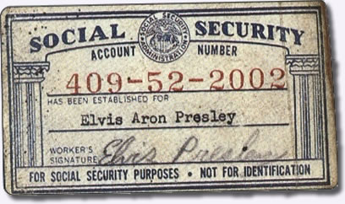
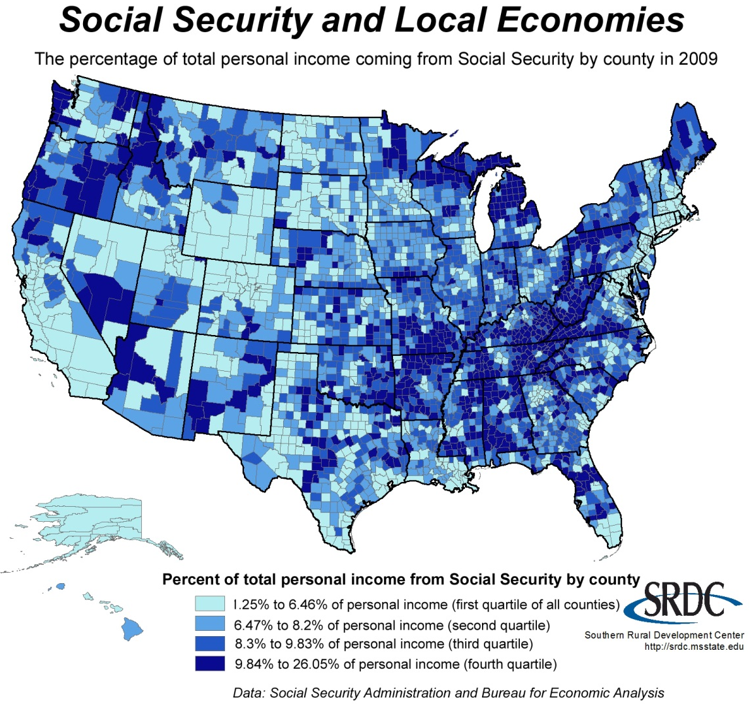
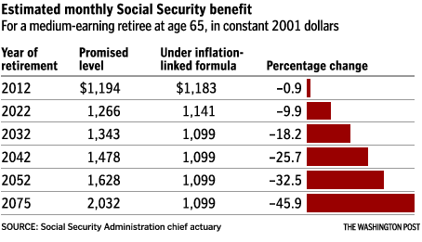
4th Core Belief
Social Security is a legal Obligation not entitlement
Workers paid into SS program similar to deposits into a bank;
Under NO CIRCUMSTANCES should age be adjusted upward or amount paid each month reduced. SS should only be for old age retirement.
Notes:
4th Core Belief: The USA Party proclaims that Social Security is not an entitlement that congress can restrict, it is an obligation. American citizens paid into the social security program, similar to how savings are deposited into banks, and legal action would be taken against a bank that said it could not pay back all the deposit with all the interest to its depositors. Under no circumstances should the age of those to receive social security be adjusted upward or amount paid each month be reduced. However, as you can see on this slide, many people have been encouraged from their state officials to switch from getting state welfare to social security disability until more than 26% of the population in some counties receive social security. The USA Party wishes to stop this action by transferring the social security disability program to the states, but maintain the old age retirement program with the federal government. And finally there should be no cap or no limit on how much income is subject to social security tax.

Slide 15

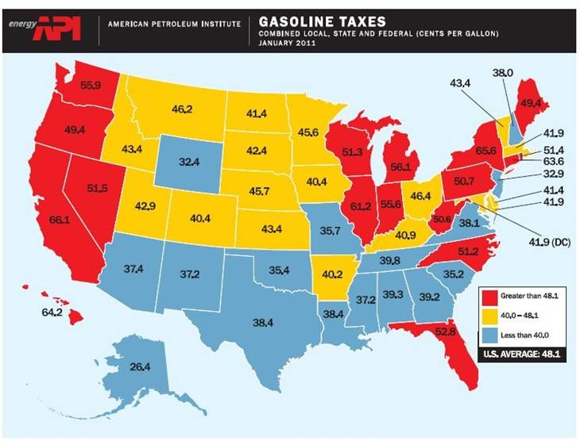
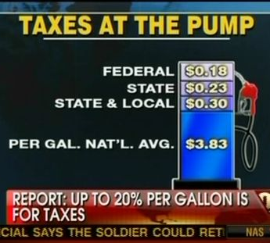
5th Core Belief
Dept of Transportation independent of US Treasury General Fund
Tax revenue on fuels only for roads
Air traffic controllers & airport screeners no longer federal workers, but employed by airports from fees on airline tickets.
Future sequester = no flight delays
Notes:
5th Core Belief: We believe that funding for the department of transportation should be totally independent of the US treasury general fund. Only taxes on fuel will pay for roads. Air traffic controllers and airport screeners should no longer be federal workers, but employed by the airports and only fees on airline tickets will pay their salaries. As a result, any future sequester of the federal spending will have NO effect on the number of air traffic controllers and therefore will not cause any flight delays.

Slide 16
6th Core Belief
The USA Party demands the elimination of slavery in America
America should look at immigration as way of rewarding its citizens with jobs
SLAVERY IN AMERICA
If an undocumented worker has been in the country for longer than 5 years & is not making more than poverty level – they are de facto slaves.
For the sake of the undocumented worker, seek out and send back to their home country.
IMMIGRATION TO AWARD CITIZENS WITH JOBS!
America should do all it can to entice immigrants to our country who can start businesses and create jobs.
1,000,000 new immigrant citizens who created 25 million high paying jobs in America is a far better policy than 1,000,000 illegal immigrants who take 1 million jobs from our poorest citizens.
Notes:
6th Core Belief: The USA Party demands the elimination of slavery in America. If an undocumented worker has been in this country for longer than 5 years and is not making more than the poverty level, then by definition, they do not have skills needed by our society and are de facto slaves to their employers. For the sake of the undocumented worker, they should be sought out and sent back to their home country by all means possible. We do not want to create slaves in America.
On the other hand, The USA Party believes America should look at immigration as a way of rewarding its citizens with jobs. America should do all it can to entice immigrants to our country who can start business and create jobs. One million new immigrant citizens who created 25 million high paying jobs in America is a far better policy than 1,000,000 illegal immigrants who take 1 million jobs from our poorest citizens.

Slide 17
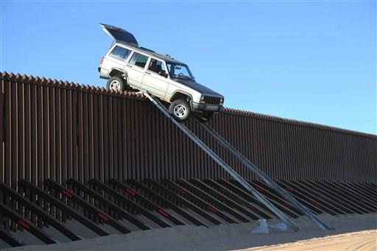

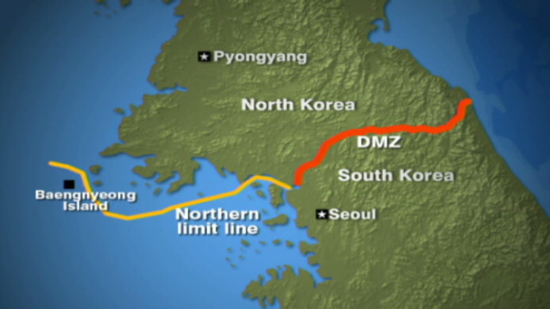
7th Core Belief
If there were 11 million failures to secure Korean Border; they would be at war!
Does it make since to have 30,000 of our troops immobilized on Korean Border to tightly secure their border when our own border is so porous?
WE SAY: “Pull 80,000 troops from overseas and placed along our southern border with 80,000 continental troops to prevent any more “guns” from crossing the border in response to insult/demand from Mexican President on 20MAY2010.”
WE SAY: “US military should create ships & aircraft that can rapidly transport 1,000’s of troops from southern US border to anywhere in world in times of need.”
Notes:
7th Core Belief: If there were 11 million failures to secure the Korean border, they would be at war right now. It would be unfathomable for a North Korean to think about driving over their border in an SUV. So does it make sense to have 30,000 of our troops over there to tightly secure their border when our own border is so porous? We advocate that 80,000 troops should be pulled from overseas and placed along our southern border with 80,000 troops relocated from the interior of USA until the border is secured and no more guns are smuggled into Mexico. The troop levels in Korea did not change while 2 wars were raging nearby. We say, the US military should create ships (the size of aircraft carriers) and planes that can rapidly transport troops from our southern border to anywhere in the world in a short amount of time.

Slide 18

8th Core Belief
America has most ASININE policy toward Coal & Energy
Rather than burning coal in the most regulated & most filtered power plants in the world, we ship the same coal thousands of miles to the least regulated & least filtered power plants in the world.
As a result: China can generate electricity & steel cheaper than America
While America imports more than 50% of the petroleum consumed in the US, we actually have a surplus of coal and natural gas.
By using maximum amount of natural gas for transportation, we will:
  Use more domestic energy resources and
  drive up the demand for and cost of electricity, which will
  cause the renewable energy resources to have a better Return On Investment leading to their greater use
USA only receives 16.54% of its imported oil from the Persian Gulf, but carries entire burden of ensuring Persian Gulf is open
Japan, India, China, and S. Korea are far more dependent upon Persian Gulf oil than the USA.
Chinese Power Plant
Notes:
8th Core Belief: America has the most asinine policy toward coal. American politicians have discouraged the use of the cheapest energy source in this country to the point that coal is being shipped to China. Does this make any sense? Rather than burning coal in the most regulated and most filtered power plants in the world here in America, we ship the same coal thousands of miles to the least regulated and least filtered power plants in the world. The carbon footprint produced by one ocean going coal barge alone may offset all of America’s solar energy investment for one year.
As a result of America’s energy policy, China can generate electricity cheaper than America and thereby out compete us on energy intensive products (such as steel, which is produced from coke); thus sending jobs to China; while producing much more pollution in the world than had the coal been burned in US coal fired plants.
While America imports more than 50% of the petroleum consumed in the US, we actually have a surplus of coal and natural gas. Please realize that most of the petroleum is utilized for transportation, while coal, natural gas, nuclear, and renewable energy sources are utilized for space heating and electricity. Very little wind & solar renewable energy sources are used for transportation, but instead offsets the amount of coal and natural gas consumed in the US for space heating and electricity. Renewable energy resources must compete against the world’s cheapest energy resources (coal and natural gas) to generate electricity. By using natural gas and electricity in the transportation industry we hope to use more domestic energy resources and drive up the demand for electricity, which will cause the renewable energy resources to have a better Return On Investment leading to their greater use.

Slide 19


9th Core Belief
Americans do not want JOBS – They want CAREERS
This administration spent nearly a $1 trillion on shovel ready jobs and thinking that is a good thing.
In 6 months, most of these building projects are completed & workers return to the unemployment lines.
Americans want CAREERS, not JOBS.
WE SAY: “America should make massive investments in automation (to bring manufacturing jobs back to America) and energy recovery. “
$1 Trillion spent on energy recovery & automation projects will produce far more long lasting & well-paying careers than these “shovel ready” jobs.
Notes:
9th Core Belief: The USA Party believes that most Americans do not want jobs. This administration spent nearly a $1trillion on what it called shovel ready jobs and thinking that is a good thing. What happens 6 months after these “jobs” are created, we would have the same number unemployed because the building projects are completed. These are not the jobs people want; Americans want careers, not jobs. The USA Party believes the federal government should invest $1trillion in technologies and automation that would give companies located in America an advantage over companies located in countries with MUCH cheaper labor. Thus creating lifetime careers here in America.

Slide 20
10th Core Belief
THEY SAY, “Our kids are failing due to bad teachers.”
WE SAY, “You’re evaluating both incorrectly.”
If a student can’t read & receives a failing grade,
  the parents will blame the teacher and say the teacher doesn’t “LIKE” the child;
  a combative relationship between the parents and teacher will result.
Receiving an “A” in one school has no bearing on a student’s performance or abilities in another school;
  Did the child really understand the subject, or does the teacher just want to please the parents?
  How does an “A” from a Charter School relate to an “A” from a failing school?
WE SAY, “Replace the A, B, C, letter grading system with a numbering grading system”;
  A grade of 3.5 means the student reads as someone halfway through the 3rd grade.
  ON AVERAGE the students will advance by at least 1 number grade during a school year from a good teacher.
  ON AVERAGE the students will advance less than a 1 number grade during a school year from a poor performing teacher.
We wholeheartedly support school vouchers for private schools as a means of educating our youth without burdening our teachers with today’s non-educating issues.
WE SAY, The federal government should enable states to develop the tests that will determine the number grading system & how it relates to other countries abilities.
Notes:
10th Core Belief:
They say, “Our kids are failing due to bad teachers.”
We say, “You’re evaluating both incorrectly.”
If a student can’t read & receives a failing grade, the parents will blame the teacher and say the teacher doesn’t “LIKE” the child;
a combative relationship between the parents and teacher will result.
Receiving an “A” in one school has no bearing a student’s performance in another school;
Did the child understand the subject, or does the teacher just want to please the parents?
How does an “A” from a Charter School relate to an “A” from a failing school?
We say, “Replace the A, B, C, letter grading system with a numbering grading system”;
A grade of 3.5 means the student reads as someone halfway through the 3rd grade.
ON AVERAGE the students will advance by at least 1 number grade during a school year from a good teacher.
ON AVERAGE the students will advance less than a 1 number grade during a school year from a poor performing teacher.

Slide 21
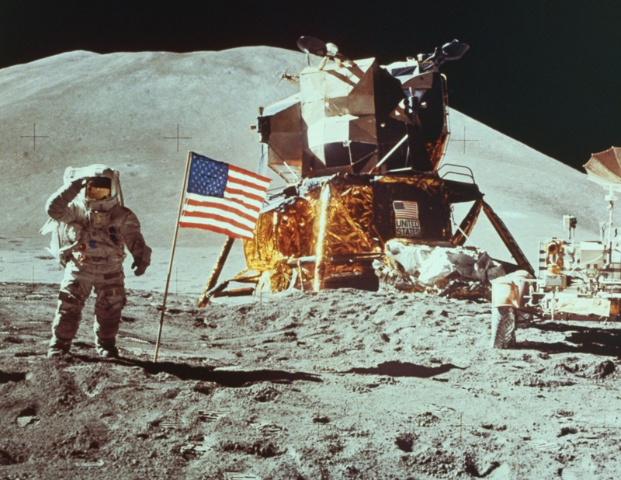
11th Core Belief
America MUST send men to the MOON & Beyond
THEY SAY, “Why spend money on NASA or space exploration when there is so much need here.”
WE SAY, “4.5 times more is spent on Food Stamps & 59 times more spent providing other goods & services to the needy.”
WE SAY, “Go ask anybody from other countries around the world,
“When was America greatest?;
  when it landed on the moon in 1969 or
  when it spent $1 Trillion on its needy in 2014?”
Notes:
11th Core Belief: Finally, and most importantly, America MUST send men to the moon and beyond.
They Say, ”why spend money on NASA or space exploration when there is so much need here?” We say, “4.5 times more is spent on Food Stamps & 59 times more is spent providing other goods & services to the needy compared to the entire NASA agency budget.”
For those of you who still need an answer, we say go ask anybody from other countries around the world, “when was America greatest; when it landed on the moon in 1969 or when it spent $1trillion on its needy just in 2014?” The entire Apollo moon program cost $109B over 10 years in today’s money. While the American moon program is a source of great pride to those still in the space program, it is absolutely embarrassing that our astronauts must obtain rides into orbit from our former moon program rival. It seems incredulous that a space program that was championed by two democratic presidents in the ‘60’s has fallen to its lowest point by a democratic president 40 years later.

Slide 22


11th Core Belief continue
Commercialized Space Program via Space Billets
We have invested ~$800 Billion over 45 years on NASA since Armstrong walked on moon with little to show. We must change how space business is conducted.
We must determine where we will be in 50 years as a space faring nation and create a plan.
We must utilize the immense purchasing power of federal government to establish a robust space industry by securing long term, fixed contracts (we refer to as Space Billets) for space transportation and space hotels.
A Space Billet is fixed contract for 10 tons at $1,000/lb of useful payload (or 3 astronauts) to Low Earth Orbit that greatly expands America’s Space Program
250 missions/years x 10 tons @$1,000/lb = $5B/year
At 3,000 missions/yr; price to Space Hotel reduced to under $600,000.
Space Billets: Don’t develop a rocket to put things into orbit, but instead provides a guarantee market of 250 missions per year at a fixed low price that can be used by the government or purchased by private companies.
Space Billets: Don’t build Space Hotels or expensive Space Stations, but guarantees that at least 52 visitors will spend 10 weeks/year at space hotels
Space Billets: Don’t develop a vehicle to land on the moon, but instead guarantees a market to transport 20 visitors to the moon per year
Notes:
11th Core Belief continue:
We are not advocating another government-ran moon program because Congress, NASA, and its contractors have gotten very smart at delaying the program with cost over-runs until $billions are wasted. Instead, the USA Party wishes to commercialize space by a method of establishing guarantee aerospace markets that we refer to as “Space Billets”.
Space Billets will allow ANY commercial American company to deliver goods and astronauts not only to orbit, but to the moon and beyond.
Space Billets doesn’t develop and spend nearly $3B per year just to maintain an expensive space station just for a few astronauts, instead it guarantees that at least 52 visitors will spend 10 weeks at a commercial space hotel per year for the next 5 years if a commercial company can provide one to NASA’s specifications.
Space Billets doesn’t develop a vehicle to land on the moon, but instead it guarantees a market to transport 20 visitors to the moon over 5 missions per year for 5 years if a commercial company wanted to provide those services.
Space Billets doesn’t develop a rocket to put things into orbit, but instead it provides a guarantee market of 250 missions per year at a fixed low price that can be used by the government or purchased by private companies. Instead of major aerospace contracts going to the same large aerospace companies, any American company in ANY congressional district can reserve a Space Billet. Space Billets and the commercial aerospace markets they create, will enable us to do all of these things at nearly the same amount of funding currently going to NASA.

Slide 23
HEALTHCARE
WE SAY: “Health insurance adds at least 40.4% more to the cost of health care than just paying with cash or credit card while providing no incentive to save”
Health Insurance should only be Rarely Utilized; like car insurance
WE advocate: Healthcare Savings Accounts (HSA) with very high deductible Health Insurance Plans (VHDHP).
When compared to all other insurance plans, VHDHP is cheapest for almost all yearly healthcare expense scenarios.
HSA provides an incentive to seek lowest cost healthcare provider and obtain healthy lifestyle since HSA will convert into an Individual Retirement Account when you reach 65
WE SAY: Entrepreneurs should create a website of healthcare providers (e.g., http://hospitalbuddy.com) similar to one of our favorite websites, http://gasbuddy.com .
WE SAY: “Eliminate financial burdens from chronic illness by stipulating that the expenses of an illness can be carry-over multiple years until the Deductible is met and the Catastrophic Illness insurance would pay for that single illness for life”. In addition, any medical expense that occurs within 30 or 60 days is considered one illness (e.g., pneumonia while being treated for a heart attack is considered the same illness.)
Notes:
Healthcare:

Slide 24
End political hot button by eliminating the ACLU’s use of the “establishment clause” by making atheism a religion
ACLU say the 10 Commandments are offensive.
Here are 3 versions. If 1 is not offensive, then how could any be offensive
Notes:
Throughout my book I try to provide solutions to sources of political bickering. One of those sources of political bickering is the 10 commandments.
The ACLU is an organization that prides itself on removing all traces of religion from our society and they have often targeted the 10 commandments in public buildings. The ACLU has tricked the US government in promoting one religion (Atheism) over all other religions.
I have provided 3 versions of the 10 commandments for your consideration. If one version is not offensive, then how could any version be offensive?

Slide 25
WATER FOR LA & GREAT PLAINS
WE SAY: “Ocean Thermal Energy Conversion (OTEC) can provide an abundance of clean, fresh water and fish from the ocean as well as provide a means for massive carbon sequestration”
OTEC is not a great energy source, but a great way of:
  removing green-house gases from the atmosphere,
  carbon dioxide from the ocean water, making the oceans less acidic,
  cleaning up the oceans of garbage,
  creating profitable fish farms,
  removing hurricanes energy sources, as well as
  supplying clean drinking water to the dry areas of the world.
WE SAY: “A large aqueduct (the size of the California Aqueduct) should be built to transport water from the Missouri River (near Lake Francis Case) to Lubbock, TX and all points in between.”
In 2011, the Missouri River sustained record flooding while western Texas was enduring one of its worst droughts.
Notes:
WATER

Slide 26
Conclusion
The USA Party – Join the Silent Revolution & Return Power to the People
We seek Independents, Libertarians, the Tea Party, Republicans, Centralists, Moderates, the Green Party, and “everybody else”.
We believe power should be removed from DC and returned to the states, returned to the people.
Unlike Libertarians, we believe the states can have as many laws and as much control over our lives as we the people agree to.
And finally, we believe the federal government should be inspiring, guiding, and assisting its citizens to accomplish the nearly impossible.
If you have liked what you have heard and you are tired of all of the political non-sense, we hope you download our book at THEUSAPARTY.com and join us in returning power to the people.
We don’t ask for money! We will not accept donations if offered. We only ask that you share this website with your friends and your opinions, comments, and technical papers with us in our Publications Page, because your voice matters.
This is the Silent American Revolution, no one (especially the IRS) needs to know you are a member
Notes:
Conclusion:
We are neither Democrats, Republicans, nor Libertarians; We are the The USA Party and we believe as much power as possible should be removed from DC and returned to the states, returned to the people.
In the USA party, we believe the federal government should be inspiring, guiding, and assisting its citizens to do the nearly impossible.
Unlike Libertarians, we believe the states can have as many laws and as much control over our lives as we the people agree to. As you have seen in a previous slide, the American people have vastly different concepts on how much government should be involved in their lives. So why should we continue to have an overreaching federal government performing local government functions? No matter which party is in control, nearly half the populace will be dissatisfied, so why shouldn’t we return power to the states and let the people determine their fate.
If you have liked what you have heard and you are tired of all of the political non-sense, we hope you visit our website at THEUSAPARTY.com and join our new American Revolution and return power to the people. We don’t ask for money, we only ask that you share this website and presentation with your friends.

