Slide 1
Sub-Orbital Passenger Aircraft for Space Launch Operations
51th AIAA/ASME/SAE/ASEE Joint Propulsion Conference, Orlando, Florida
28 July, 2015, AIAA 2015-3894
Douglas G. Thorpe*
Space Propulsion Synergy Team & Co-founder of theUSAparty.com; Mt. Sterling, KY
Daric Escher‡
LibertyWorks Rolls-Royce, Indianapolis, IN 46225-1103
Russel E. Rhodes (ret.)†
NASA Kennedy Space Center, Florida, 32899

Slide 2
Summary
CONCEPT: Originated as a result of Thorpe’s proposal to Darpa’s ALASA program.
SERIES: Follow-on paper to our 2012 and 2014 work
PURPOSE: Provide high-level concept that shows a Hybrid Suborbital Aircraft (HSA) can be used for passenger Point-To-Point (PTP) and Earth-To-Orbit (ETO) operations to achieve remarkable costs reductions
RELATIONSHIP: This work was performed to satisfy the opportunity promoted in Thorpe’s “Space Billets” paper
Space Billets = Provide guaranteed flight rate at a very low fixed price
IN THIS PAPER: We looked at several supersonic aircraft and validate their performance against our flight simulation program
GOAL OF AIRCRAFT: Transport
300⁺ passengers more than 5,000 miles or
deliver 200,000 lb gross weight upper stage & payload to the Karman line.
200,000 lb upper stage could deliver 40,000 lb to LEO

Slide 3
What We Determined
What is the optimum flight scheme?
Do we utilize combine cycle / air breathing engines OR utilize turbojet with rocket engines to highest speed and altitude
PTP flight range, flight path, wing loads, and inlet conditions of the different versions of a 675,000 lb gross weight PTP-HSA?
Maximum staging speed & altitude
Airport operations:
How would our vehicle be more of a commercial success than the Concorde?
How do we load LH2, LOX, Liq methane, and Jet-A safely, quickly (less than 30 minutes), and cheaply?
Compare the proposed system with the Andrews Space Peregrine reusable launch vehicle
What are the strategic military advantages of a fleet of 1,000 aircraft?
Is a Mars mission on any given day possible?

Slide 4
Why Include Passenger Service
The commercial passenger airline industry absolutely dwarfs the Earth-to-Orbit (ETO) transportation market
($5,000B vs $2B) via 642 million passengers on 8.9 million airline flights each year vs less than 543 to EVER go into space with a maximum of only 26 commercial space flights each year.

Slide 5
Ground Rules and What We are Trying to Accomplish
To cause least impact to airport operations, 1st generation aircraft use (Jet-A);
2nd generation aircraft could use liquid hydrogen (LH2) for greater range.
The aircraft should be modeled in passenger capacity, Maximum Take-Off Weight (MTOW), and range after the Boeing 2707
300 passengers
675,000 lb MTOW
312,500 lb = 46,575 gallons of Jet-A fuel
6,000 mile range (the Boeing 2707 had a stated range of only 4,250 nm with 275 passengers)
NO bent nose (the Boeing 2707 nose bent in two places)
Expected Revenue / flight: $400,000 (300 pass. * $1,333 ave ticket price one-way)
6 flights/16 hour work day = $2.4M revenue / work-day vs $2,324,638 for Qantas Flight 7
Obtain very high altitude & high Mach then glides as far as possible OR cruise @ Mach 5
Target average velocity of Mach 4.5
Minimum fleet size of 75 aircraft; target fleet size of 1,000
Maximum development cost of $15B
Be easily modified to launch upper rocket stages (and payloads) at Mach 6⁺ or fly passengers on same day
We have set a target of 20,000 lb (10 tons) of useful payload if flown due east from NASA-KSC into a 100 mile circular orbit.

Slide 6
To achieve these goals
The aircraft must be extremely adaptable by being able to convert from a passenger aircraft into an ETO air launcher and back into a passenger aircraft within one work shift
No horizontal stabilizer (to provide longer platform)
No retractable wings (to reduce cost and complexity)
Retractable forward canards (to land at slower speeds)
Airplane wing should be designed to take advantage of compression lift, such as the wing design by the XB-70 Valkyrie.
A lift-to-drag ratio (L/D) that is at least 75% of the maximum theoretical L/D
Utilize the air inlet technique of the Concorde & not the SR-71
Use four to six J-58 engines (or equivalent)
Use expander cycle, linear aerospike engines on each wing with multiple combustion chambers for each engine
If placed inside J-58 engine, aerospike engines would need to produce 250 klb thrust each

Slide 7
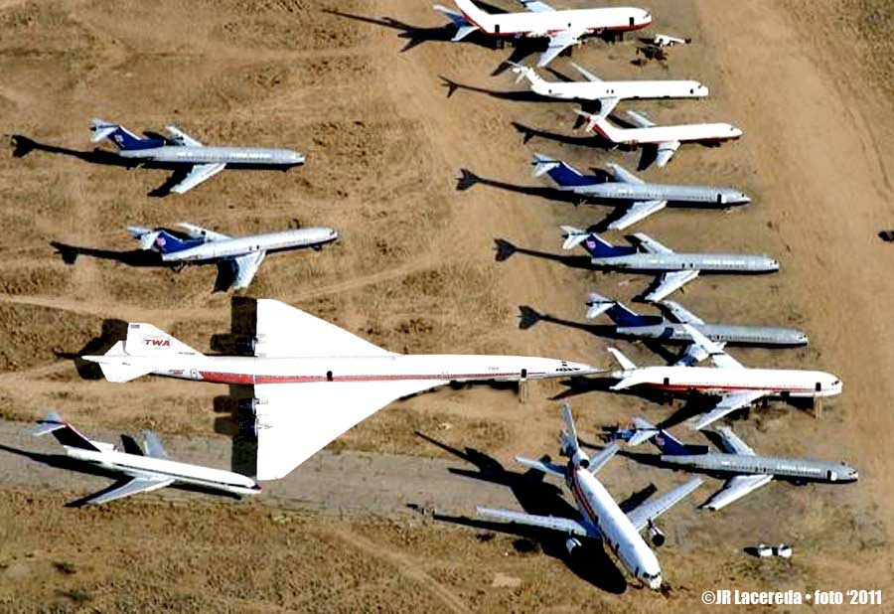
Boeing 2707 in relation in size to common aircraft
Aircraft is much larger than Boeing 787 even though they carry same # passengers because passengers sit 4 & 5 abreast in the 2707, versus 9 abreast in 787

Slide 8
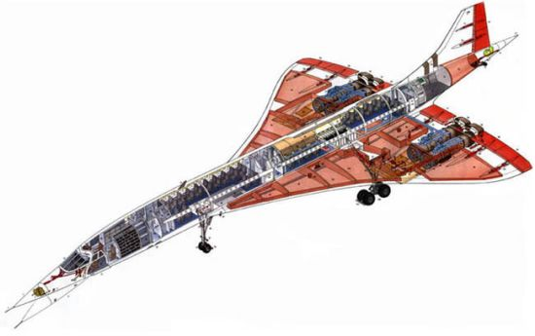
Internal schematic of Concorde showing fuel tanks, engines, & passenger chairs, etc
NOTE: The absence of a rear horizontal stabilizer
The Boeing 2707 design has a fuselage whose diameter varies over the cabin section.
This is done to reduce the interference wave drag between wing and fuselage.
This was not done on the Concorde as it was felt that the increase in production costs would be too high.
For our vehicle, having the same width fuselage is VERY important to how we load and unload aircraft

Slide 9
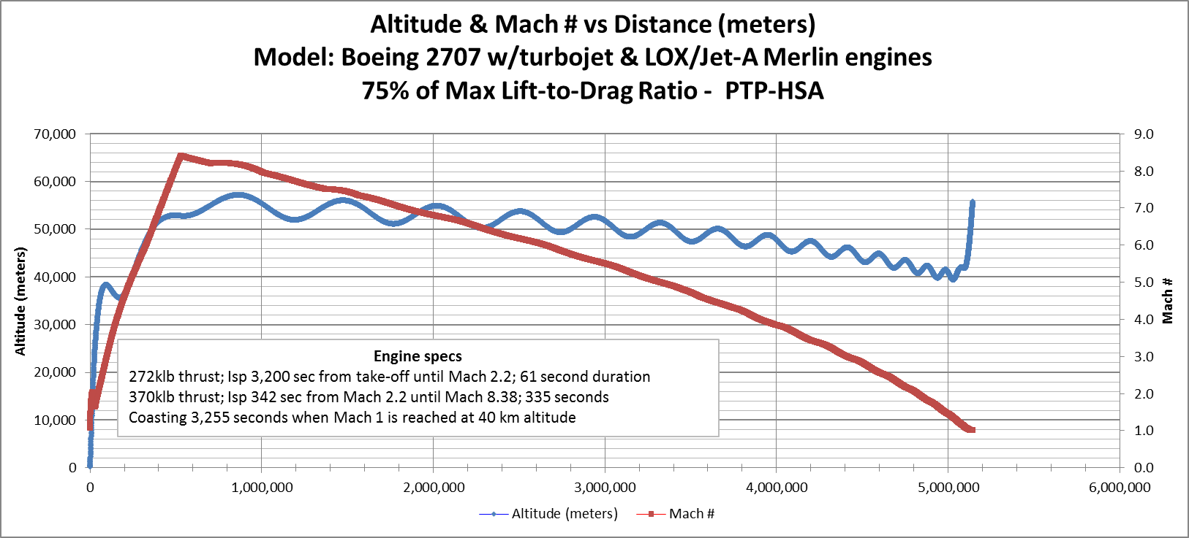
1st Generation Fictitious Boeing 2707 sized aircraft with turbojet and LOX / Jet-A rocket engines
Min L/D = 4.07 at Max speed of Mach 8.38, but all fuel has been consumed; vehicle weighs only 45% of MTOW. As a Result: aircraft experiences same drag it would encounter at Mach 1.49 when fully loaded.
Total Flight Simulation Time: 3,663 seconds
Average Mach #: 4.2 = 1,405 m/s
Maximum Altitude: 57km = 187,000 ft = 35.4 miles
Aircraft slowed to less than Mach 1 causing flight simulator program to cause error
Notes:
Nearly all $55,600 (100,260 lb of Jet-A and 267,900lb of LOX) propellants are consumed after aircraft has traveled 3,400 miles in 65 minutes and reached a maximum altitude of 57km (187,000 ft). NOTE: LOX is a renewable energy source that is derived from electricity and costs about $0.04 per pound.

Slide 10
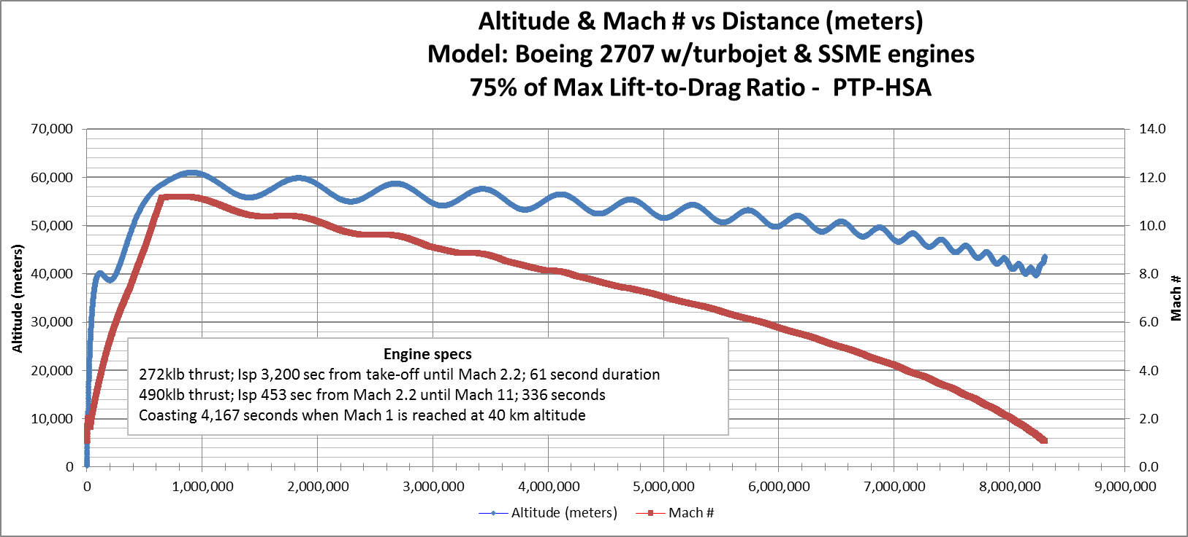
2ndGeneration Fictitious Boeing 2707 sized aircraft w/ turbojet & LOX-LH2 rocket engines
Min. L/D = 3.81, occurs at max. speed of Mach 11.08
Total Flight Simulation Time: 4,580 seconds
Average Mach #: 5.44 = 1,816 m/s
Maximum Altitude: 61.4km = 201,000 ft = 38 miles
Min. Gravity (straight & level flight): 7.43 m/sec²

Slide 11
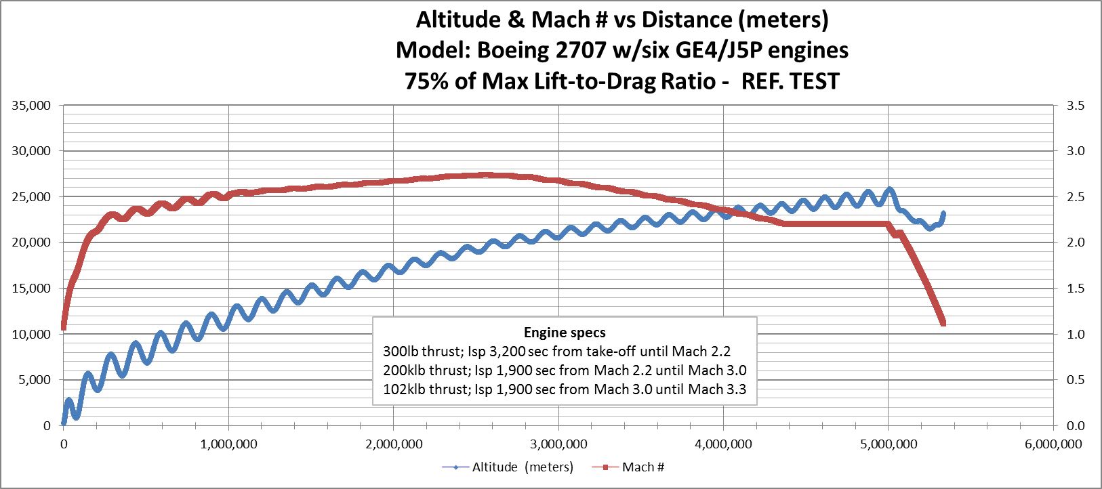
Actual Boeing 2707 with six GE4 engines and no rocket engines
Same Lift-to-Drag ratios at all speeds as before. Max speed = Mach 2.71
Only travels 5,330 km (~3,300 miles) in 127.1 minutes before consuming all fuel
Stated cruising speed and range for the Boeing 2707 is Mach 2.7 and 7,870 km
Could not get the aircraft to climb faster without major porpoising (bouncing).

Slide 12
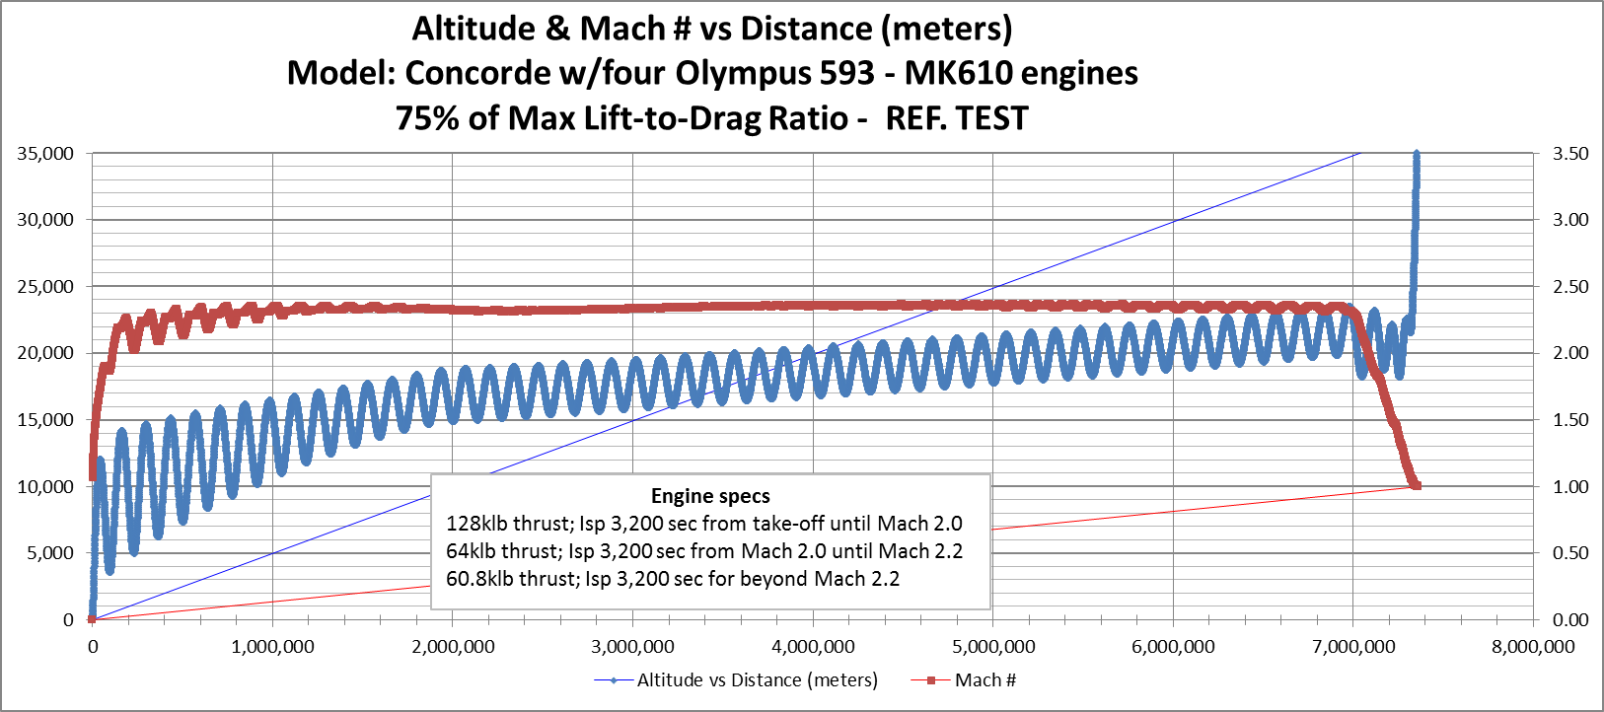
Concorde w/four Olympus 593 – MK610 engines
To authenticate the simulation program, we ran a simulation on the Concorde aircraft.
Found maximum speed = Mach 2.2, range = 7,400 km after 3.26 hours before we ran out of fuel.
Our aircraft exceeded the service ceiling of 60,000 ft when its weight was reduced from burning fuel.
Normal Concorde maximum speed = Mach 2.2, range = 7,222 km, and a Service Ceiling of 18,300 meters.

Slide 13
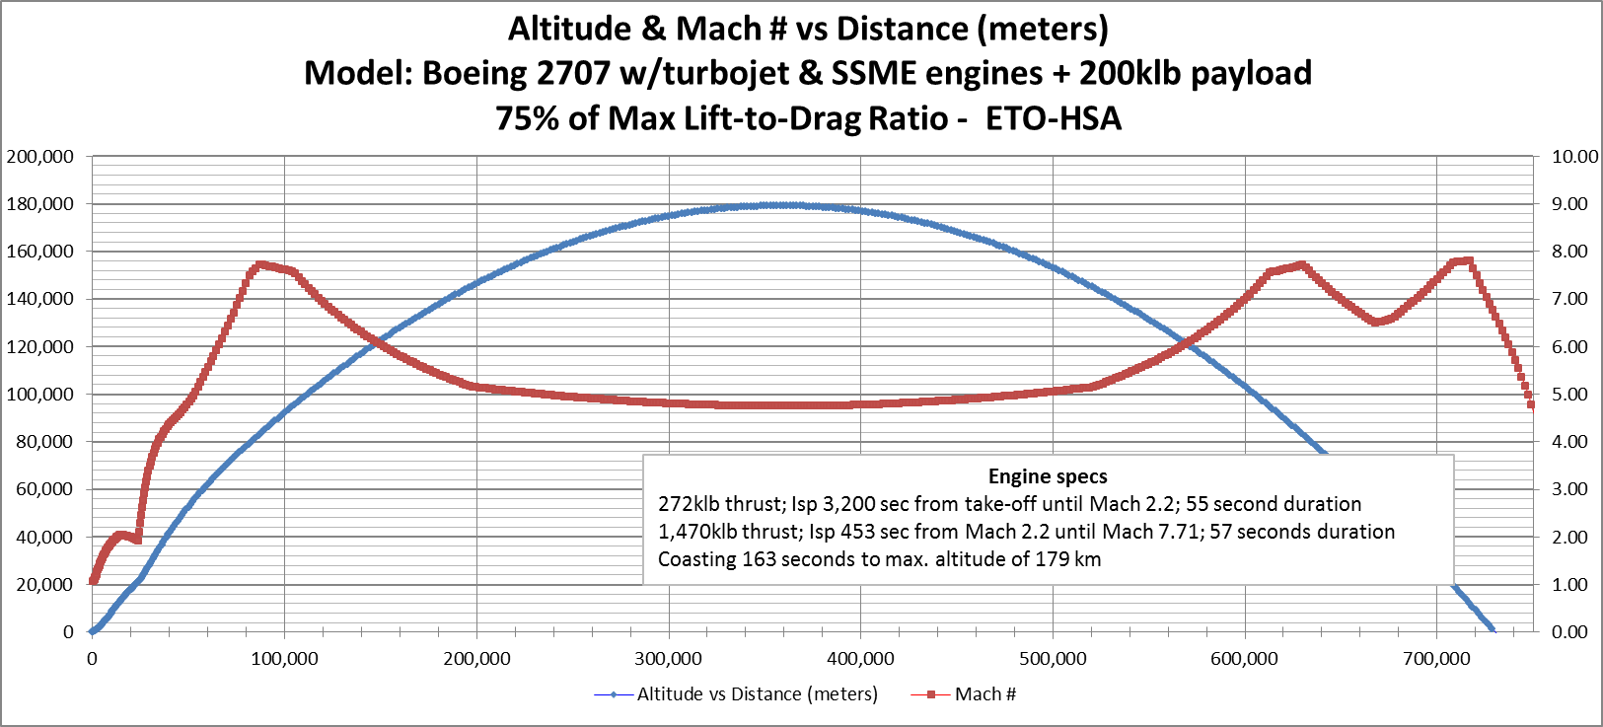
2nd Generation fictitious Boeing 2707 w/turbojet & LH2/LOX engines as Air Launcher
Passenger Service is great, but the point of this paper is to develop an aircraft that can be modified into an air launcher.
Aircraft can deliver 200,000 lb (upper stage & payload) at Mach 7.71 and 179 km altitude
Maximum altitude: 179 km = 587,120 ft = 111.2 miles
1,470 klb thrust LOX/LH2 engines on aircraft only fire for 57 seconds
Space tourists can hitch ride for extended zero-g ride
All passengers and crew eligible for astronaut wings

Slide 14
How do we quickly convert a Passenger Aircraft into a Freighter
Start with an aircraft that has a flat fuselage except for flight deck.
Attach four (48 ft long) Passenger Compartment Modules; 75 passengers each
PCM are totally self-contain; include passenger chairs, windows, galleys, bathrooms, HVAC, oxygen, CO2 absorbing LiOH canisters, pressurization system and doorways, & parachutes large enough to support a single PCM.
Passengers SURVIVE mid-air catastrophes.
PCM are removed at airport with passengers & luggage and are transported to connecting flight and loaded separately after plane is fueled
Passengers are moved with PCM at connecting airports; no more dashing across airport to catch a connecting flight (for most people)
One of four 48’ long PCM detached for clarity
HSA = 300 ft (Concorde is only 200 ft)

Slide 15
Compare the proposed system with the Andrews Space Peregrine reusable launch vehicle
+ Our system focuses on dual use of the aircraft while the Peregrine is single purpose. As a result:
Our aircraft can be utilized 6 times per day for passenger services and once per night for ETO missions
The Peregrine can only be utilized to carry the 28 commercial missions per year; resulting in much higher fixed cost per mission.
+ Our system has 3 times more thrust from the air breathing engines. Results in 3 x MTOW, --→ our upper stage is > 3 times more massive.
? Our upper stage is deployed from a payload bay
Peregrine is deployed from a bomb bay.
+ Our flat fuselage design will accommodate changes in the Cargo Bay Module for oversized and odd size payloads
Peregrine bomb bay dimensions wouldn’t appear to be easily changed.
+ Our system emphasizes LOX-LH2 upper stage (and LOX-LH2 aircraft rocket engines for the 2nd generation)
Peregrine currently shows only solid rocket propulsion for the upper stage.
+ Our larger total mass to orbit means a totally reusable upper stage can still deliver minimum 10 tons of useful payload to orbit.
Peregrine is 1/3 size and uses less efficient solid propellants for the upper stage, very doubtful if such upper stage system could ever be within an order of magnitude in $/lb of our totally reusable system.

Slide 16
Strategic Military Advantages of civilian PTP-HSA with ETO capability: Fleet of 1,000 aircraft
On any given day: 6,000 sorties will transport 300 passengers at least 4,000 miles (1.8 million passengers daily)
On any given day: 1,000 sorties could take place to remove 1,000 enemy satellites or 1,000 pieces of orbital debris via each sortie spraying tons of water in their pathway
On any given day: 1,000 sorties could launch 1,000 replacement satellites.
One any given day: 1,000 sorties could send 200,000 lb military payloads from above the KARMAN line to fulfill the requirements of SUSTAIN (Small Unit Space Transport And Insertion)
On any given day: 100 sorties could launch a mission to Mars at a fraction of the cost for traditional launch operations;
Instead of launching 10-100 ton SLS rockets,
Launch 100-10 ton payloads to LEO with 1/10th fleet of aircraft
Total Cost $430M = $4.3M for 10 tons of payload to LEO = $215 per pound
$1.5M for HSA + $2.8M for upper stage.

Slide 17
CONCLUSION
We hope we have provided ample evidence to prove that there is some merit to an aircraft that is propelled by a rocket engine to very high Mach numbers and very high altitude to achieve great average speed and reduced costs.
This paper should provide convincing evidence that such an aircraft would be extremely competitive in the commercial passenger mid-range Point-To-Point markets.
Very recently, Boeing forecast demand for 38,050 new airplanes valued at $5.6 Trillion over the next 20 years.
Now is the time for a new supersonic aircraft to be developed to meet this demand.
Now is the time to develop an Earth-To-Orbit supersonic air launcher that can finally move us away from missile technology to a totally reusable ETO system.
We hope that you agree that only because the aircraft is designed for the gigantic commercial PTP passenger market, that there is finally a financial rationale for developing a supersonic air launcher for ETO market.
The next step with this concept is for government and the aviation industry to:
take a closer look,
fund an in-depth study, and
conduct experiments to prove the concept.
Otherwise, passenger service will be stuck at sub-sonic speeds for many years to come, but most importantly, the cost of going into space and the envision of thousands of visitors per year traveling to a space hotel will not be practical with the current foreseeable evolution of missile derived launch systems.

