Slide 1
Nuclear Fusion Power Plant that Could Produce 100% of North American Energy
Douglas G. Thorpe
KYrocketman@gmail.com
02May 2017

Slide 2
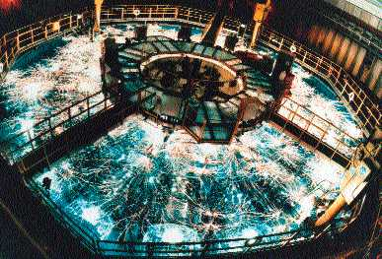
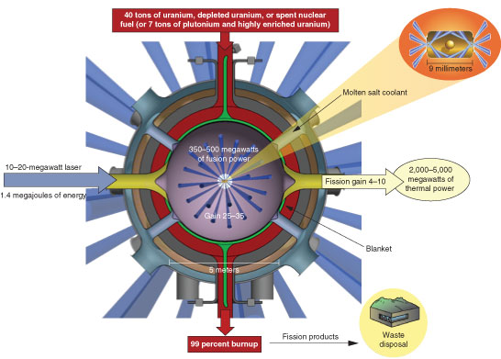
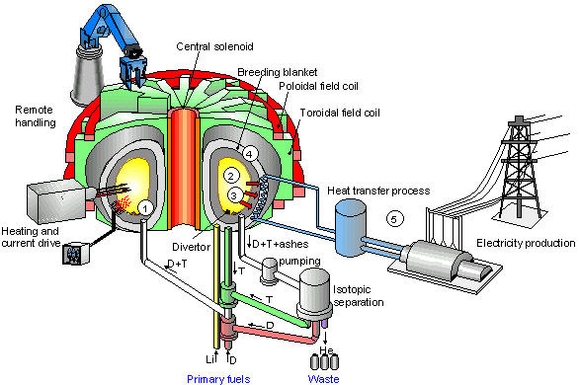
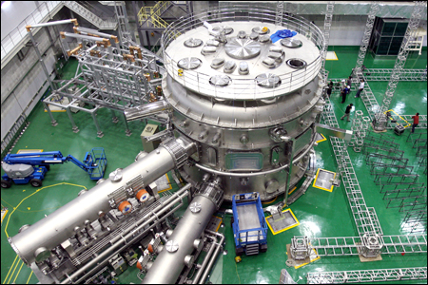
These guys have been at it for 62+ years; spent $29.1B (US only) and need another 20+ years and $48 Billion more to achieve 500MW for 400 sec!

Slide 3
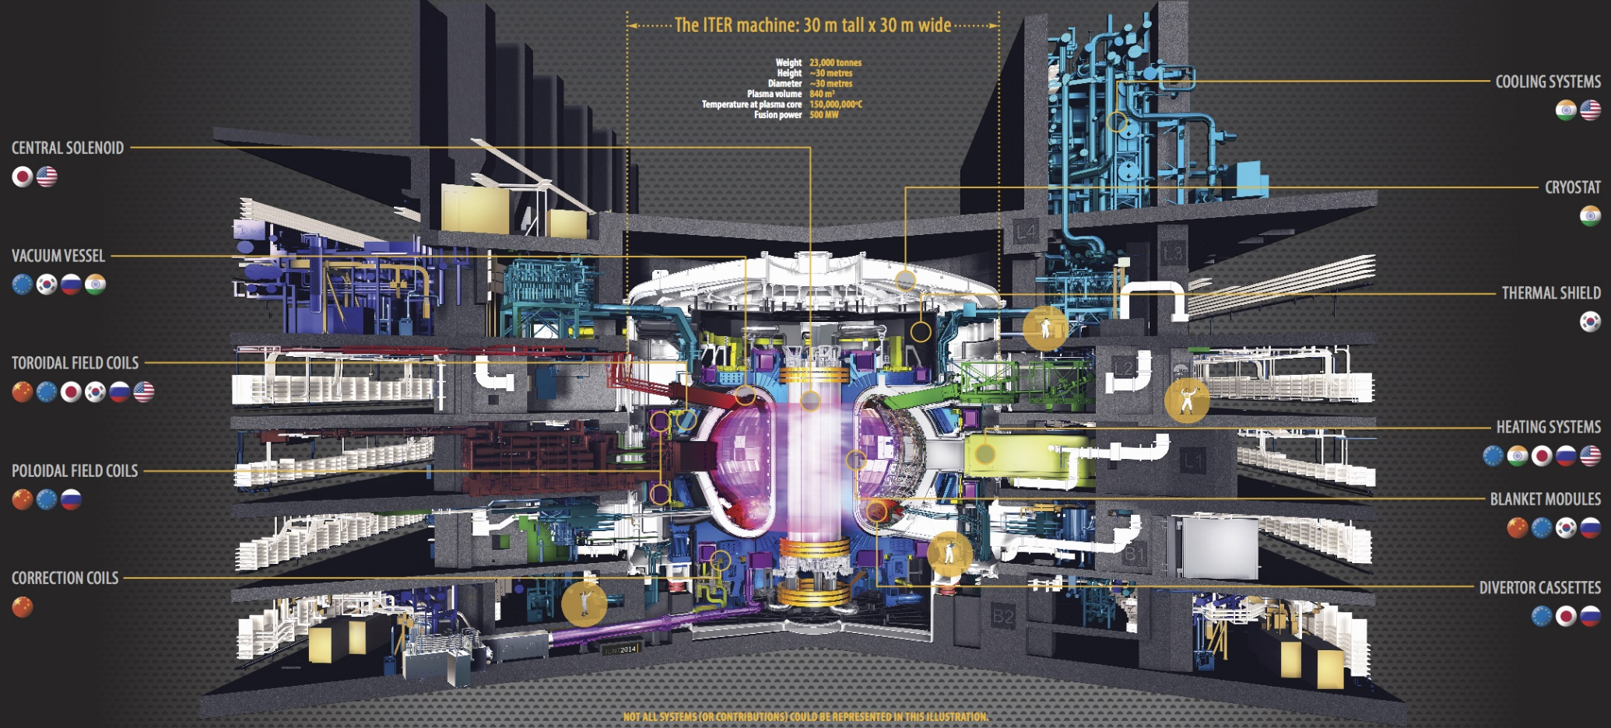
To scale up to 500 GW, the ITER machine would need to be 10 times taller x 10 times larger in dimeter (300m x 300m dia) and would cost 1,000 times more ($48,000 B)!
If we assume a thermo-efficiency of 33% for the steam generation process and a 50% efficiency in the fusion process (i.e., half of electricity is used for containment), 500 MW of useful electricity output would require 3,000 MW of heat energy from the fusion process.
Heat energy to the steam system must be pulled through the containment system!!!??
Operating on a razor’ edge: each hour, they must inject precisely 42grams of Lithium & precisely 12g of D while precisely removing 48g of He; Helium must be quickly removed or it will interfere with the reaction. 4 grams of neutrons per hour will slowly contaminate the entire structure.
Just how do you remove Helium from a plasma containing Deuterium without losing a lot of energy?
These systems are colossal, they are expensive, they are complex, and they will never power the nation!!!!

Slide 4
Similarities between Traditional Fusion Reactors and Thermonuclear Devices
Nuclear fusion has been a pipe-dream for physicists since 1953, and the latest estimate is that we are still several decades and several more $ billion are needed before net gigawatts of energy can be obtained via nuclear fusion.
On the other hand, thermonuclear fusion is old-hat technology for the world’s nuclear weapons.
Both fusion weapons and fusion energy rely on fusing Lithium-Deuterium into Helium,
Thermonuclear fusion weapons rely on a fission primary-explosion comprised of highly-concentrated U-235 or Pu-238 to set off the fusion reaction while traditional nuclear fusion energy systems have tried (without success) to use non-fission means.

Slide 5
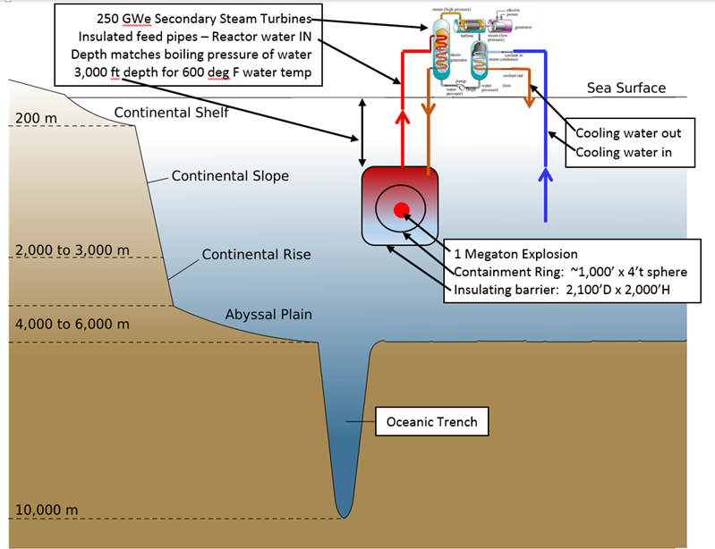
Solution – Option 1
Thermonuclear devices should be exploded in a controlled environment and heat from the fusion reaction explosion contained to generate steam for electric turbine.
250 GW reactor should be built in 10,000 ft deep water off of each seaboard
30 miles east of Cape Hatteras, NC and
12 miles west of the Farallon Islands, CA
An airport (not shown) will be constructed on the ocean surface over the reactor chamber
Steam turbines located at the airport on the surface with 3,000 ft long insulated feed pipes to the chamber
There may be 5,000 ft of water below the chamber.
Steam turbines produce high voltage DC which is sent 100’s miles to large energy consumers.

Slide 6
Solution – Option 2
Reactor chamber located at bottom of the ocean to place highest pressure on explosion to reduce effects.
Instead of long, insulated feed pipes, steam turbines located in multiple, unmanned, remote controlled submarines
Each submarine contains 1GW steam turbine system
Submarines are flooded so hydrostatic forces are not a factor, except at turbine.
As more power is desired from system, more submarines are added.
As more submarines are added, thermonuclear devices must be detonated more often.
Submarines can attach to 8ft diameter ports located every ½ degree around circumference of reactor chamber; a total of 720 submarines can be attached to the reactor chamber at 1 time.
Submarines can be detached and brought to surface for maintenance.
Submarines are not shown to scale for clarity

Slide 7
Bomb Calculations
1 ton of TNT = 4.184 GJ
Average Annual USA electrical power demand: 444 GW
GJ to equal 444 GW/hr: 1,600,000 GJ
Tons of TNT to equal 1.6 million GJ: 382 kilotons
Assume 33% efficient steam generation system = 1.15 Megaton
A 1.15 Megaton device will need to be detonated each hour to fulfill the ENTIRE ELECTRICAL REQUIREMENTS FOR THE USA!!!
Instead of a single 444 GW power plant, utilize a 250 GW power plant on each seaboard = 650 kiloton device in each plant every hour
or a 1.3 Megaton device in each plant every other hour.
Financials
1GW power plant revenue = $50,000 per hour (gross)
250 GW power plant revenue = $12,500,000 per hour = $110 Billion/year
Modern Coal Fired Power Plant costs $1/watt of power
Wind power is usually 3 times as much per watt
Construction costs of 250 GW fusion plant should be no more than $250B to be competitive with coal or $750B to be competitive with wind

Slide 8
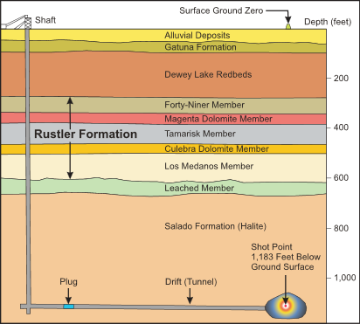
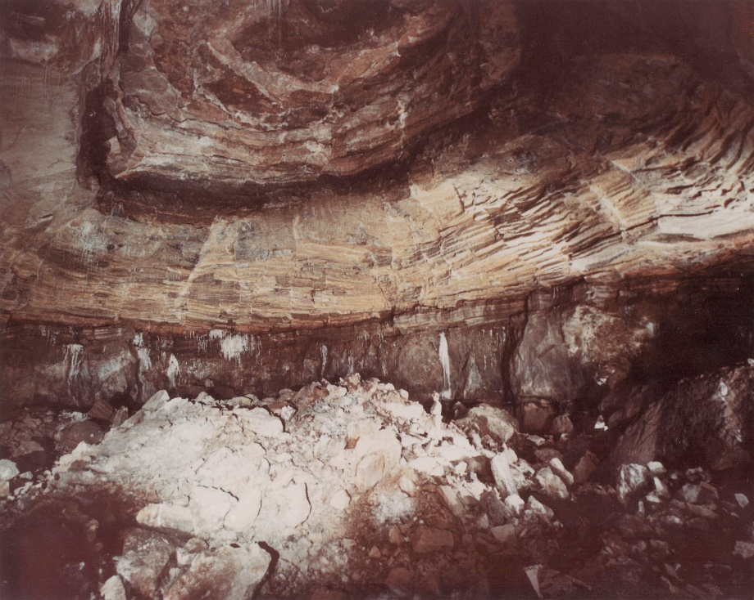
Project Gnome
Edward Teller, the father of the hydrogen bomb, conceived of obtaining electricity from thermonuclear bombs
He would detonate a 1 kiloton bomb every 45 minutes in a 100’D x 300’ cylinder with 4’ thick steel walls or explode the bomb in a large salt dome.
Project Gnome tested Teller’s concept
A 29 kT thermonuclear device was exploded 1,183 below ground in salt dome
As originally delineated, Teller’s plans were uneconomical because the greatest cost of the thermonuclear device is the high grade U235 or PU-239 in the primary.
Soviets demonstrated a primary of only 300 tons for a 15 KT device for the Pechora–Kama Canal as part of the Taiga Soviet peaceful nuclear explosions of the 1970s
Therefore, if we utilize a 1 megaton fusion device with the same 0.3 KT Pu-239 primary, our Pu-239 costs will be over 1,000 times less expensive per energy output than Teller’s.

Slide 9
Underwater Nuclear Explosion
Operation Hardtack and Operation Wigwam were underwater nuclear explosion tests.
Hardtack was 9 kiloton explosion in 500 ft deep water;
Wigwam was 30 kiloton explosion in 2,000 ft deep water. Very little surface spray was generated due to very deep explosion.

Slide 10
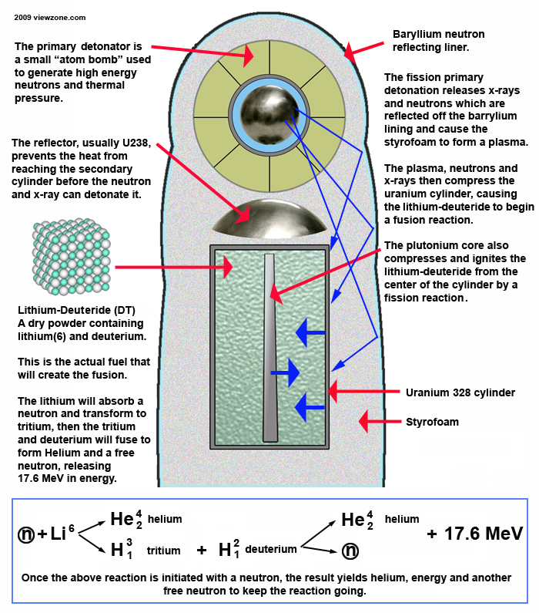
Nuclear Fusion Fundamentals
The nuclei of tritium and deuterium both have a positive charge and naturally repel each other.
Enormous pressure and energy must be used to compress them and allow the "strong nuclear force" to take over.
This is achieved by detonating a small fission atomic bomb in the confined space of the bomb casing and designing special reflecting surfaces to focus the intense x-rays and neutrons from this primary explosion to the secondary cylinder where the hydrogen will fuse.

Slide 11
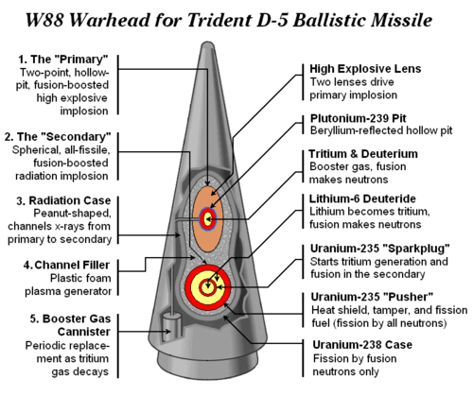
Warheads
W88 Warhead
Newest weapon:
400 in service
Prod: Sept88-NOV89
Yield up to 475 kt within a package of 68.9 in (1.75 m) long, maximum diameter of 21.8 in (0.55 m), and weighing less than 800 lb (360 kg)
W76 warhead
(most common in US arsenal)
2,000 in service
Produced: Jun78-Jul87
yield of 100 kilotons and weighs 362 lbs.

Slide 12
Shock Wave Abatement
As with most explosions, a shock wave is going to be produced that will be detrimental to any structure that is not designed to withstand it.
We believe a curtain of heavy, suspended spherical metal objects that is hung around the explosion point could withstand the effects (heat and pressure) of the shockwave as well as transfer that energy to the surrounding water.
We envision the shock wave curtain to surround the explosion point several hundred feet from the point of explosion
Without the shock wave abatement curtain, the insulated steel liner would need to be much thicker

Slide 13
Nuclear Security
It has not escaped the fact that we are talking about nuclear weapons that are 100 times larger than used in WW2.
To prevent the thermonuclear device (or even just the primaries) from escaping into the wrong hands:
Manufacture the primaries on military bases.
By separating plutonium from nuclear reactor spent fuel rods
Manufacture everything but primaries at separate facility.
Construct a floating airport over power plant.
Transport dozens of primary halves to power plant every month via military aircraft.
Assembly thermonuclear devices at the power plant.

Slide 14
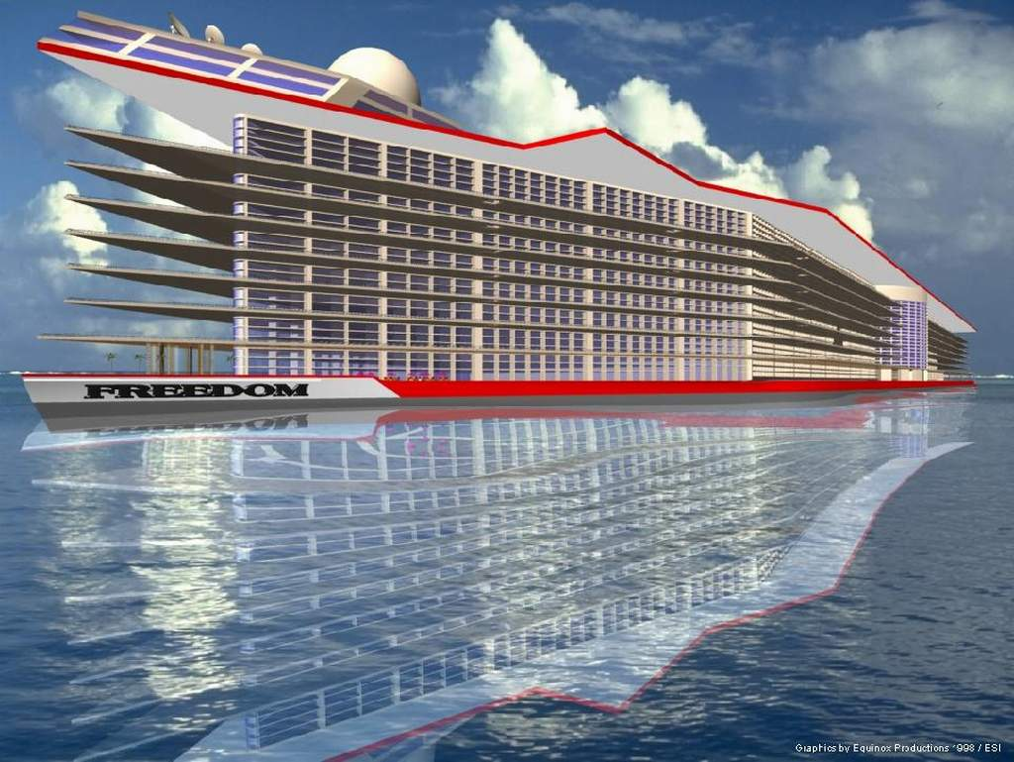
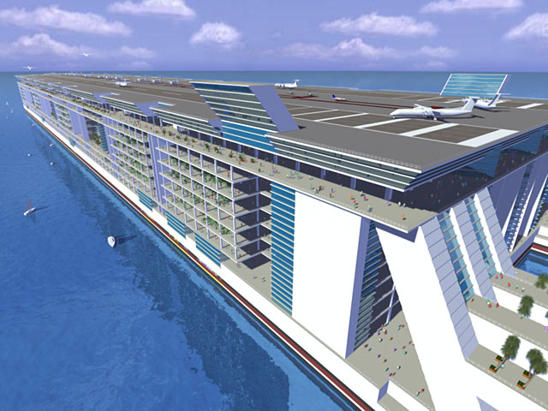
Construction Sanity Check
Does it make sense to construct a 2,000 to 6,000 ft diameter double-hull cylinder that is insulated and built to withstand the forces of a nuclear blast?
Below are sketches of a $10 billion floating city, “Freedom”.
Freedom is 4,320 foot long x 750 foot wide x 25 story tall vessel that will be home or hotel to 100,000 people (including 20,000 crew) with a private airport on top.
Freedom will displace 2.7 million tons, ~4 times more than Seawise Giant
If Freedom can be taken seriously, then shouldn’t a fusion power plant that can power the entire USA.

Slide 15
Concerns & Technical Challenges
Spent nuclear fuel rods contain up to 11% of plutonium, but how do you recover this fuel source?
How large of a thermonuclear device should be utilized and how do we mitigate the shock waves from their detonation?
How much does it cost to manufacture twenty-four 1.3 megaton thermonuclear devices per day?
Should extremely clean (e.g., 95% fusion with inert spark plugs and tampers) thermonuclear devices be utilized OR should we utilize “boosted” thermonuclear devices (with U-238 spark plugs and tampers)?
Should we care if radioactive waste is created since the waste will be forever contained by the reactor?
Very hot, very radioactive nuclear waste will accumulate in the water;
Fresh water won’t become reactive but salt water will
Should we try to fill the reactor with fresh water while it is being constructed or salt water
If we place one or more safety curtains around the reactor to contain any spill, how do we get coolant water to the submarines?
We envision 1GW flooded, remote control submarines. A heat exchanger separates the reactor water from the steam cycle so only thing contaminated is the pump and ports. Can a steam generator be remotely controlled in this manner?
Is high voltage DC the optimum manner in distributing the electrical power?

Slide 16
Conclusion
Nuclear fusion has been a pipe-dream for physicists since 1953 and the latest estimate is that we are still several decades and more $ billion are needed before net gigawatts of energy can be obtained via nuclear fusion.
On the other hand, thermonuclear fusion is old-hat technology for the world’s nuclear weapons.
This proposal could harness CLEAN (No CO2 or green-house gases) fusion energy from thermonuclear devices today!
The previous page contained a list of Concerns & Technical Challenges,
Traditional Nuclear Fusion technologies have technical challenges with no clear path forward.
Our technical challenges are really just engineering problems of scale.
The biggest unknown: Can a peaceful thermonuclear device be manufactured on a daily basis and cost less than ~$25M for a yield of ~1.3 megatons?
Note: One Trident 2-D5 missile carries 14 W88 (475 kiloton) warheads or 14 W76 (100 kiloton) warheads.

