Slide 1
Man-Made Global Warming is Political hype A technical paper by TheUSAparty.com
http://theUSAparty.com
The USA party is a grass-roots organization dedicated to end all federal political bickering
Notes:
“Man-Made Global Warming is Political hype” A technical paper presented by TheUSAparty.com
The USA party is a grass-roots organization dedicated to end all federal political bickering.

Slide 2
The USA Party http://theusaparty.com
Who is The USA Party
Earth has always been much warmer than today
A runaway Greenhouse Effect is Impossible
CO2 in atmosphere, Least amount in 500 million years
We have consumed 13% of our known resources of fossil fuels, but nearly half of oil
Atmospheric CO2 measured from Ice Core Samples doesn’t match CO2 calculated from CO2 production
CO2 concentration increased immediately even though rain forests not destroyed
600% increase in CO2 production, but only 29% increase in CO2 concentration in the atmosphere
# of new China/India Coal Fired power plants dwarfs what rest of world will remove
Proof that Man-Made Global Warming is Political Hype
Conclusion: What the Political Leaders should be worried about
Notes:
In this Power Point Presentation,
you will be introduced to the USA Party
Explained how Global Warming is a return of normalcy since the earth has ALWAYS been much warmer than today
We will explain why it is impossible to have a runaway greenhouse effect
We will show that the amount of CO2 in the atmosphere today is the LEAST amount there ever has been.
We will show that from 1750 until 1950, there was more CO2 in the atmosphere than possible from burning fossil fuels.
We show how the rain forests have nothing to do with the amount of CO2 in the atmosphere
We explain how the number of coil power plants going into China and India will dwarf anything the USA and the rest of the world will remove.
And finally, we tell what the politicians should be worried about.

Slide 3
Who is The USA Party
The USA Party is grass-roots organization of Independent Voting Citizens who do not see any of the present political parties as providing a clear path to a better America
The USA Party grew out of frustration of:
Two of worst US Presidents (Bush & Obama) that spent vast sums of American wealth on 2 meaningless wars & government giveaways.
Petty bickering between the two major parties and
Cheers this President gave to a world leader while that leader insulted American Laws and our US Constitution in our own Capital Building on 20MAY2010! (Go to Immigration in Policy page to read the Great Insult.)
The federal government should be inspiring, guiding, and assisting its citizens to do the nearly impossible; instead our government is inspiring its citizens to ask for more handouts.
The USA Party was founded in Kentucky by an aerospace engineer (and several silent patriots) & inspired by YMCA’s Kentucky Youth Assembly
Because other founding members of The USA Party may have positions with the federal government or other situations where they desire to be anonymous, only Doug Thorpe will be listed as the author on all official The USA Party.com documents.
Notes:
Who Is the USA Party.
We are Independent Voting Citizens who do not see any of the present political parties as providing a clear path to a better America.
The USA Party grew out of frustration of:
Two of the worst US Presidents (Bush & Obama) that spent vast sums of American wealth on 2 meaningless wars & government giveaways.
Petty bickering between the two major parties and
Cheers this President gave to a world leader while that leader insulted American Laws and our US Constitution in our own Capital Building on 20MAY2010! Please go to Immigration in Policy page to read all about the Great Insult.
We believe the federal government should be inspiring, guiding, and assisting its citizens to do the nearly impossible; instead our government is inspiring its citizens to ask for more handouts.
The USA Party was founded in Kentucky by an aerospace engineer (and several silent patriots) as well as inspired by the YMCA’s Kentucky Youth Assembly
Because other founding members of The USA Party may have positions with the federal government or other situations where they desire to be anonymous, only Doug Thorpe will be listed as the author on all official theUSAparty.com documents.

Slide 4
Earth has always been much warmer than today
Global Warming is a return of normalcy.
Earth's surface has always been much warmer than today except during global ice ages (around 300 million years ago) and the last 3 million years when South America connected to North America (ending the Central America Seaway)
The temperature at the poles was nearly the same as at the equator.
In the chart below, you can see that 55 million years ago (at the end of the dinosaurs), the planet was 14 deg C warmer than today
Note: The bottom axis (X) changes to ever increasing time as you go from right to left on the chart; so 5,000 years on the far right side of the chart is equal in x-distance as much as 100 million years on the far left of the chart
Notes:
Earth has always been much warmer than today:
Earth's surface has always been much warmer than today except for a short span (during the ice ages) around 300 million years ago and after the Panamanian Isthmus (ending the Central America Seaway) was formed 3 million years ago.
The temperature at the poles was nearly the same as at the equator.
In the chart below, you can see that 55 million years ago (at the end of the dinosaurs), the planet was 14 deg C warmer than today

Slide 5
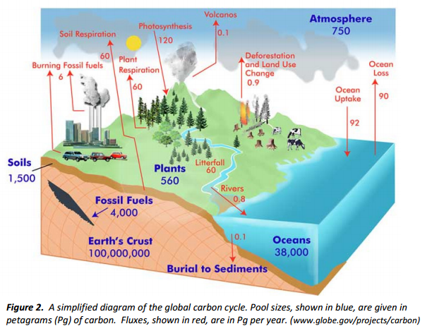
A runaway Greenhouse Effect is Impossible
Earth is 4.57 Billion year old.
In first 600 million years, the earth’s atmosphere resembled that of Venus. Yet, it transformed as biomatter took CO2 out of the atmosphere.
So how in the hell will earth turn into Venus now if we burn all of the fossil fuels and boil all of the methane and CO2 out of the ocean when nearly 98% of all carbon on the earth’s crust (78 million GTC) is tied up in limestone, marble, and calcite?
In the first 600 million years of the earth’s history, there wasn’t any organic life forms to bind the CO2 gas and as a result there wasn’t any Organic Settlements, such as:
Limestone
marble
Calcite
Coral
Peat
Coal
Oil
Natural gas or
Rain forest (or ANY plants and trees of any kind for that matter)
Notes:
CO2 in atmosphere is the Least amount in 500 million years:
Earth is 4.57 Billion year old.
In first 600 million years, the earth’s atmosphere resembled that of Venus because the atmosphere was 99% CO2 and the atmospheric pressure was approximately 7 times greater than today.
After the 600 million years, algae and other biomatter started converting CO2 into oxygen while forming organic settlements.
Yet, it transformed as biomatter took CO2 out of the atmosphere.
So how in the hell will earth turn into Venus now if we burn all of the fossil fuels and boil all of the methane and CO2 out of the ocean when nearly 98% of all carbon on the earth’s crust (78 million GTC) is tied up in limestone, marble, and calcite?

Slide 6
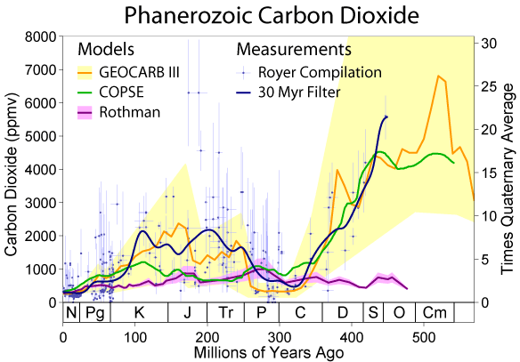
CO2 in atmosphere is Least amount in 500 million years
The world has always had more CO2 than today. In fact, the atmosphere was as much as 5% to 7% (70,000 ppm) CO2 within the last 600 million years, instead of the measly 400 ppm today.
Even more incredible is, when the earth was just formed, it’s atmosphere was as much as 99% CO2 with 7 times more pressure than today.
Two Global ice ages (frozen equator) occurred (300 & 400 million years ago) while the amount of CO2 in the atmosphere exceeded 2,000 ppm.
Notes:
CO2 in atmosphere is the Least amount in 500 million years:
The world has always had more CO2 than today. In fact, the atmosphere was as much as 5% to 7% (7% is 70,000 ppm) of CO2 within the last 600 million years, instead of the measly 400 ppm today. Even more incredible is when the earth was just form it’s atmosphere had as much as 99% CO2 with pressures several times today.
In addition, there were two Global ice ages where even the equator was frozen when occurred (300 & 400 million years ago) while the amount of CO2 in the atmosphere exceeded 2,000 ppm at that time.

Slide 7
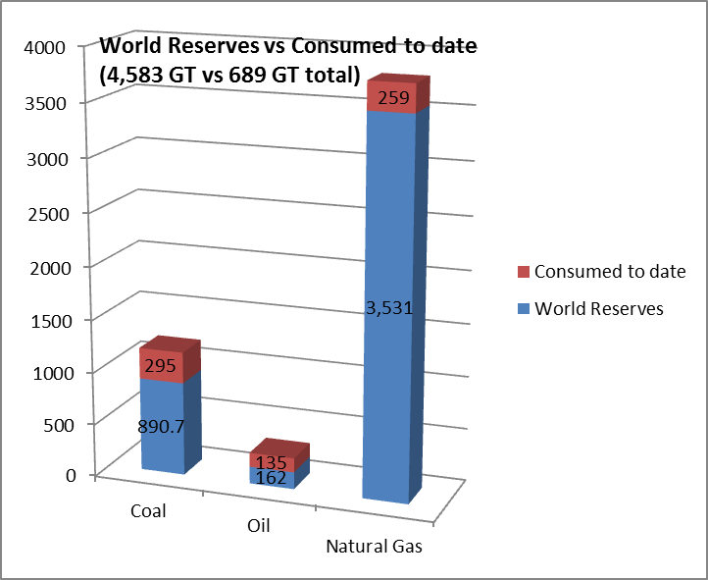
We have consumed 13% of our known resources of fossil fuels, but nearly half of oil
The world has consumed 689 GT of fossil fuels with 4,583 GT remaining; we have consumed 13% of all known reservoirs.
Each GT of fossil fuel will increase the CO2 in the atmosphere by 0.47 ppm, if no CO2 was absorbed by the ocean or plants.
So the 689 GT of fossil fuels would have increased the CO2 in the atmosphere by 325 ppm.
Since the start of the Industrial Revolution (1750), CO2 has increased in the atmosphere by only 120 ppm.
Burning ALL remaining known fossil fuels (77% is natural gas) will increase CO2 concentration by 2,154 ppm; which means at most the atmosphere would contain 2.5% CO2 if none was absorbed by plants or oceans.
Notes:
We have consumed 13% of our known resources of fossil fuels, but nearly half of oil:
The world has consumed 689 GT of fossil fuels with 4,583 GT remaining; we have consumed 13% of all known reservoirs.
Each GT of fossil fuel will increase the CO2 in the atmosphere by 0.47 ppm, if no CO2 was absorbed by the ocean or plants.
So the 689 GT of fossil fuels would have increased the CO2 in the atmosphere by 325 ppm.
Since the start of the Industrial Revolution (1750), CO2 has increased in the atmosphere by only 120 ppm.
Burning ALL remaining known fossil fuels (77% is natural gas) will increase CO2 concentration by 2,154 ppm; which means at most the atmosphere would contain 2.5% CO2 if none was absorbed by plants or oceans.

Slide 8
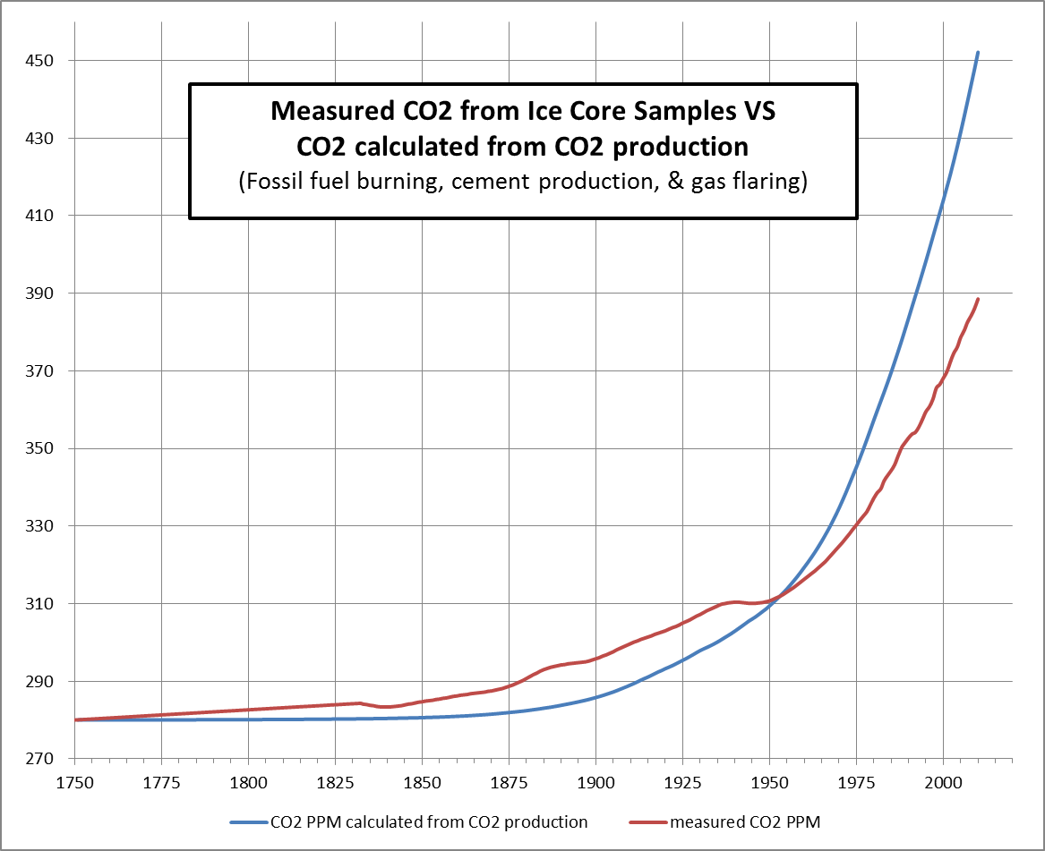
Atmospheric CO2 measured from Ice Core Samples doesn’t match CO2 calculated from CO2 production
Ice core samples are the most reliable data that provides the amount of CO2 in the atmosphere over recent history, which is plotted in the graph below.
On the same graph we plotted the calculated amount of CO2 (ppm) in the atmosphere from CO2 emitted from fossil fuel burning, cement production, & gas flaring. No allowances were made for CO2 absorbed by oceans or plant matter.
Each GT of fossil fuel will increase the CO2 in the atmosphere by 0.47 ppm, if no CO2 was absorbed by the ocean or plants.
Graph shows more CO2 in atmosphere than possible from CO2 production until 1950
Notes:
Atmospheric CO2 measured from Ice Core Samples doesn’t match CO2 calculated from CO2 production:
Ice core samples are the most reliable data that provides the amount of CO2 in the atmosphere over recent history, which is plotted in the graph below.
On the same graph we plotted the calculated amount of CO2 (ppm) in the atmosphere from CO2 emitted from fossil fuel burning, cement production, & gas flaring. No allowances were made for CO2 absorbed by oceans or plant matter.
Each GT of fossil fuel will increase the CO2 in the atmosphere by 0.47 ppm, if no CO2 was absorbed by the ocean or plants.
Graph shows more CO2 in atmosphere than possible from CO2 production until 1950

Slide 9
CO2 concentration increased immediately even though rain forests not destroyed
From 1750 to 1950, there is an increase in CO2 concentration in the atmosphere from a tiny amount of CO2 production from the burning of fossil fuels.
What makes this significant is that the world’s rain forests and non-acidified oceans did not absorb ANY CO2.
If the rain forests had absorbed CO2, the CO2 concentration would have remained flat at 280 ppm well until the 20th century.
Notes:
CO2 concentration increased immediately even though rain forests not destroyed:
From 1750 to 1950, there is an increase in CO2 concentration in the atmosphere from a tiny amount of CO2 production from the burning of fossil fuels.
What makes this significant is that the world’s rain forests and non-acidified oceans did not absorb ANY CO2.
If the rain forests had absorbed CO2, the CO2 concentration would have remained flat at 280 ppm well until the 20th century.

Slide 10
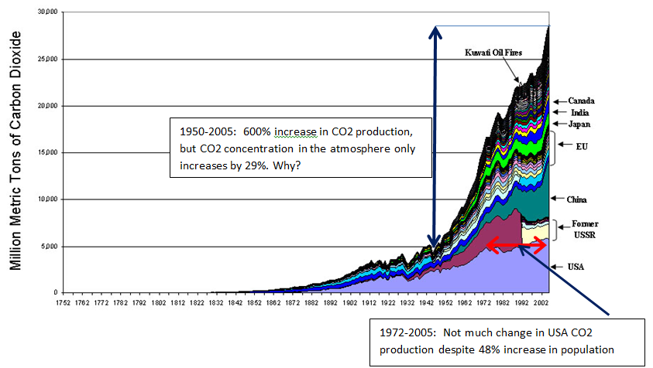
600% increase in CO2 production, but only 29% increase in CO2 concentration in the atmosphere
A graph of the CO2 production over time shows a 600% increase since 1950, but over the same time, there was only a 29% increase in CO2 in the atmosphere.
Since 1972, there hasn’t been much change in CO2 from the USA although the population has increased 48% and we are being asked to reduce our CO2 production while China’s CO2 production dwarfs our own.
Notes:
600% increase in CO2 production, but only 29% increase in CO2 concentration in the atmosphere:
A graph of the CO2 production over time shows a 600% increase since 1950, but over the same time, there was only a 29% increase in CO2 in the atmosphere.
Since 1972, there hasn’t been much change in CO2 from the USA although the population has increased 48% and we are being asked to reduce our CO2 production while China’s CO2 production dwarfs our own.

Slide 11
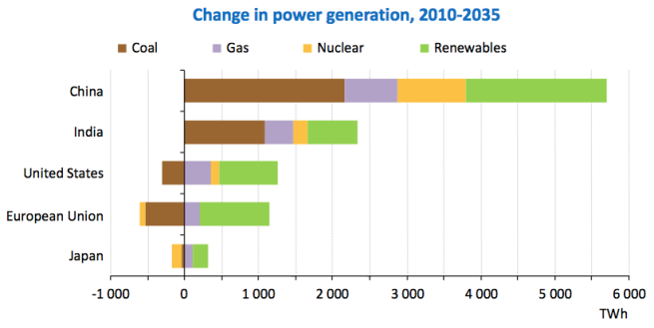
# of new China/India Coal Fired power plants dwarfs what rest of world will remove
On the previous slide we showed, that the amount of CO2 produced by the USA has not really changed that much since 1972 while the USA population has increased from 210 million to over 310 million today.
It seems incredulous that the same Greenpeace that was protesting nuclear power plants in 1972 are protesting coal-fired power plants today when the USA is producing nearly the same amount of CO2.
In next 25 years, China will add 251 GW (to its existing 758 GW in 2012) and India 120 GW of new coal fired power plants while the US eliminates 28.5 GW (of its total of 343.8 GW in 2011) in the name of reducing Global Warming
Notes:
# of new China/India Coal Fired power plants dwarfs what rest of world will remove :
On the previous slide we showed, that the amount of CO2 produced by the USA has not really changed that much since 1972 while the USA population has increased from 210 million to over 310 million today.
It seems incredulous that the same Greenpeace that was protesting nuclear power plants in 1972 are protesting coal-fired power plants today when the USA is producing nearly the same amount of CO2.
In next 25 years, China will add 251 GW (to its existing 758 GW in 2012) and India 120 GW of new coal fired power plants while the US eliminates 28.5 GW (of its total of 343.8 GW in 2011) in the name of reducing Global Warming

Slide 12
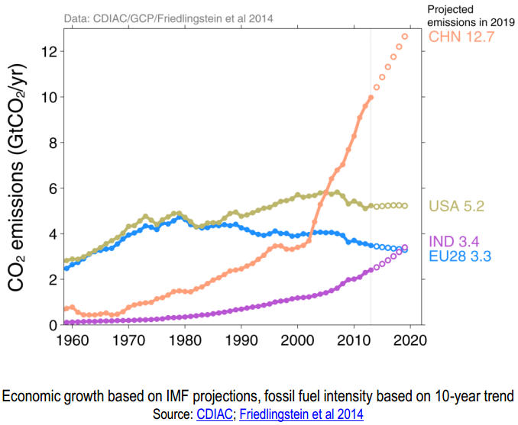
Proof that Man-Made Global Warming is Political Hype
In 1972, the USA produced 28.6% of the world’s total CO2 emissions and yet Greenpeace protested our nuclear power plants.
Today, the USA’s CO2 emissions are only 14% (China = 28%) of the world’s total CO2 emissions and Greenpeace says WE must close down OUR “polluting” coal-fire power plants
If US politicians were REALLY concerned about Global Warming, why wouldn’t we boycott goods from China and India until they halt any further increases in their CO2 emissions.
Notes:
Proof that Man-Made Global Warming is Political Hype:
In 1972, the USA produced 28.6% of the world’s total CO2 emissions and yet Greenpeace protested our nuclear power plants.
Today, the USA’s CO2 emissions are only 14% (China = 28%) of the world’s total CO2 emissions and Greenpeace says WE must close down OUR “polluting” coal-fire power plants.
If US politicians were REALLY concerned about Global Warming, why wouldn’t we boycott goods from China and India until they halt any further increases in their CO2 emissions.

Slide 13
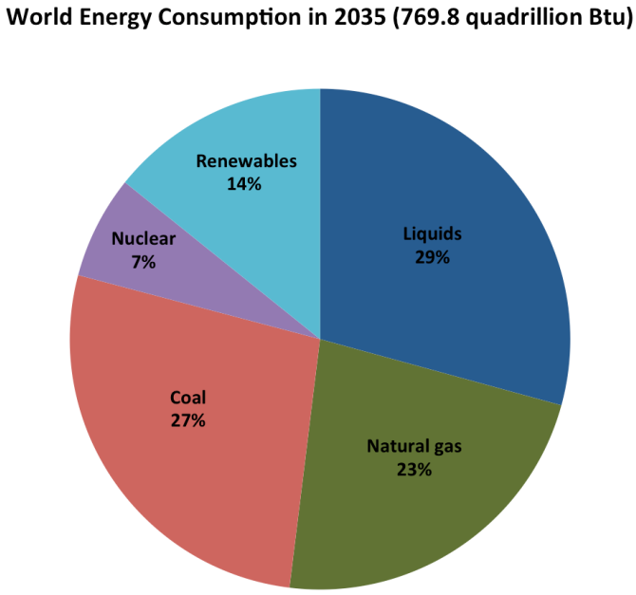
What the Political Leaders should be worried about
It’s extremely disconcerting that we have already consumed nearly half of the world oil reserves but still show that oil makes up 29% of our world energy consumption in 20 years from now.
China and India are purchasing gasoline powered cars in record numbers.
Oil provides us with so much more than fuel (e.g., plastics, lubricants, asphalt, etc.); it seems almost tragic that most of it is burned as gasoline and diesel.
If global political leaders want to lead the world away from an almost certain crisis in the future, then now is the time that we must steer away from the consumption of oil in the production of gasoline and diesel fuels and preserve this precious resource so future generations will have low cost access to oil derived products as lipstick, baby bottles, trash bags, cell phones, computers, etc.
We must convert our transportation infrastructure to utilize natural gas and electricity while the transition is less painful.
At some point, the availability of oil will hit a tipping point where the price for a gallon of gasoline will become unprecedented.
Notes:
What the Political Leaders should be worried about
It’s extremely disconcerting that we have already consumed nearly half of the world oil reserves but still show that oil makes up 29% of our world energy consumption in 20 years from now.
China and India are purchasing gasoline powered cars in record numbers.
Oil provides us with so much more than fuel (e.g., plastics, lubricants, asphalt, etc.); it seems almost tragic that most of it is burned as gasoline and diesel.
If global political leaders want to lead the world away from an almost certain crisis in the future, then now is the time that we must steer away from the consumption of oil in the production of gasoline and diesel fuels and preserve this precious resource so future generations will have low cost access to oil derived products as lipstick, baby bottles, trash bags, cell phones, computers, etc.
We must convert our transportation infrastructure to utilize natural gas and electricity while the transition is less painful.
At some point, the availability of oil will hit a tipping point where the price for a gallon of gasoline will become unprecedented.

